Slide 1
Archaeology and the Old Testament
Chapter 11: The Patriarchal Narratives
Dr. Gregg Wilkerson

Slide 2
The Patriarchal Age
Abraham to the Exodus
c.3000 to 1400 BC (or 1250 BC, Late Theory). Early to Late Bronze Age
There is no direct archaeological information
no monument or inscription

Slide 3
Liberal vs Conservative
MINIMALIST
mythical figures
combine motifs from a variety of pagan hero stories
heros have been “hebrewized” and “sanitized”
fabricated national pre-history
MAXILIST
factual eyewitness accounts
real people
real events

Slide 4
DATA SOURCES
Assyrian Cappadocia texts
Mari Tablets
Babylonian tablets
Nuzi Tablets
Elba Tablets
Amarna Tablets
Ugarit - Ras Shamrah Tablets

Slide 5
DATA SOURCES
Oatna Tablets
Alalakh Tablets
Boghazkoy Tablets
Library of Ashurbanipal: Assyrian Tablets
Nippur Tablets

Slide 6
Cappadocia Tablets
5000 tablets
18th and 19th Centuries BC
Found at Kültepe (Kanesh)
Heart of an old Hittite state
Written in cuneiform by Assyrian colonists in Cappadocia
Highly developed trade existed between Assyria and Asia Minor before 1800 B.C.

Slide 7
Cappadocia Tablets

Slide 8
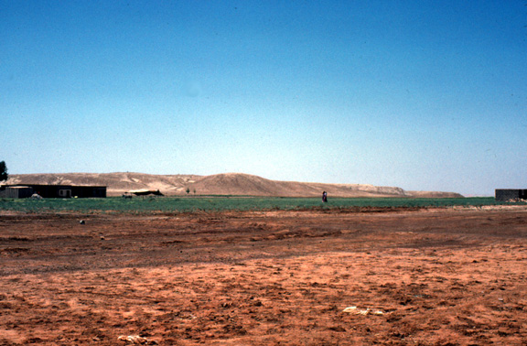
Mari Tablets
Over 10,000 tablets
Amorite capital of Mari
18th Century BC

Slide 9
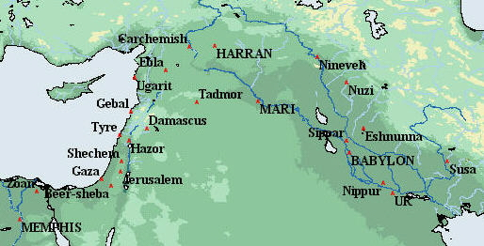
Mari
______

Slide 10
Mari
The earliest Mari settlement is dated to 3500-3000 BC
Trade rival with Ebla
South bank of Euphrates River, 15 miles north of the Syrian/Iraqi border.
The city of Mari as at the site of modern Tell Hariri and occupies 280 acres.
The Golden Age of Mari was 1860-1760 BC
Royal Palace of King Zimri Lim
9 acres with 300 rooms. It was the largest known palace in Middle Bronze Age Mesopotamia.
There were bathrooms with hard clay bathtubs, lavatories and functional plumbing.
. Mari was eventually conquered by Hammurab

Slide 11
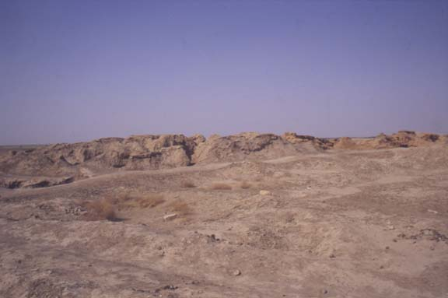
Mari Palace Ruins

Slide 12
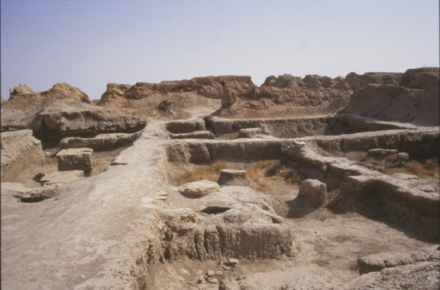
Court of Palms, Mari Palace

Slide 13
Mari Library
In the palace archive
25,000 clay tablets
Business and political correspondence
Some important chronological data
Some religious information

Slide 14
habuaru
Amorite verb
habuaru = "to immigrate" or "to seek refuge“
May be precursor of the word "Hebrew"

Slide 15
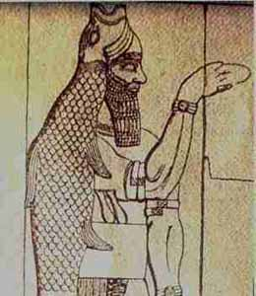
Mari Religion
Chief god is Dagon
Baal
Istar (Asherah)
El, Adad (Hadad)
DAGON, Fish God

Slide 16
Mari Prophetic Tradition
Trance
Oracle
Divination

Slide 17
Prophetic Utterances
1) accusations
2) warnings
3) exhortations
4) promise of victory

Slide 18
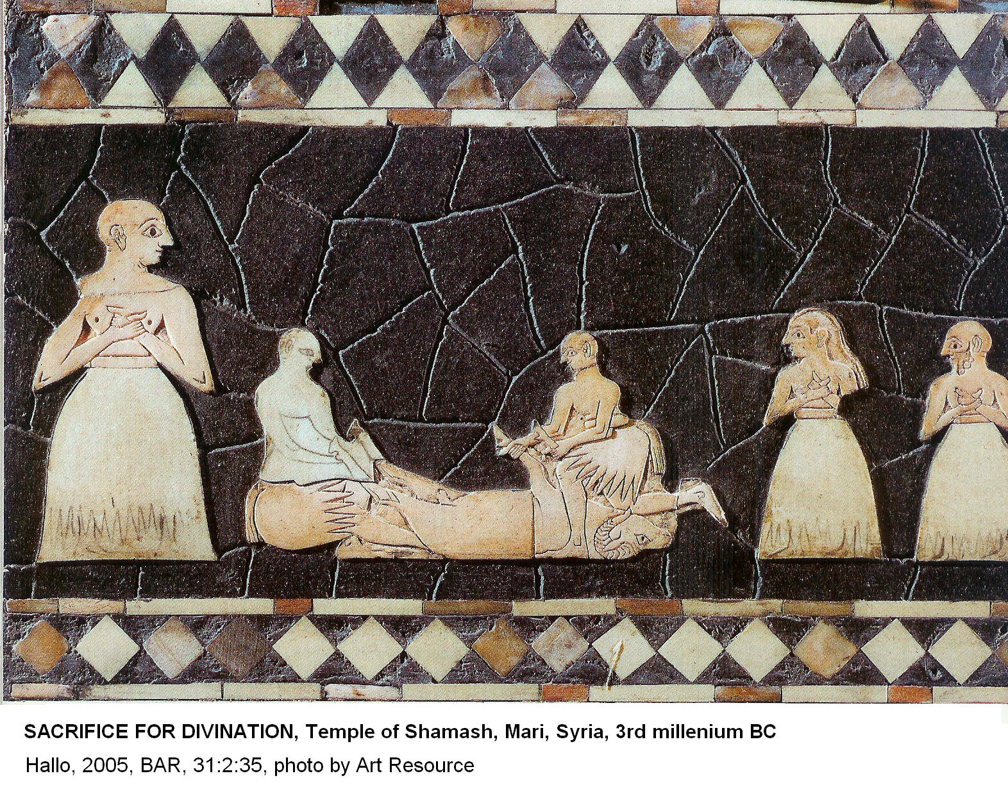
Divination

Slide 19
Biblical Place Names in the Mari Tablets
Hazor
Laish (Laish was renamed Dan in Judges 18)

Slide 20
Biblical Personal Names in Mari Tablets
Noah
Abraham
Leban
Jacob
Same names, but not biblical personages

Slide 21
Babylonian tablets
Various Babylonian cities
10,000 to 90,000 tablets in each city
1800 to 1500 BC
Old Babylonian Gilgamesh (Flood) Epic
Writings from the Chaldean and Persian eras 625 to 330 BC

Slide 22
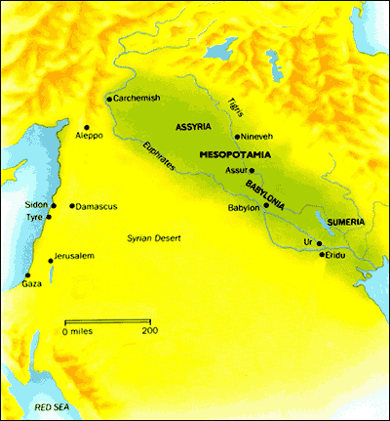

Slide 23
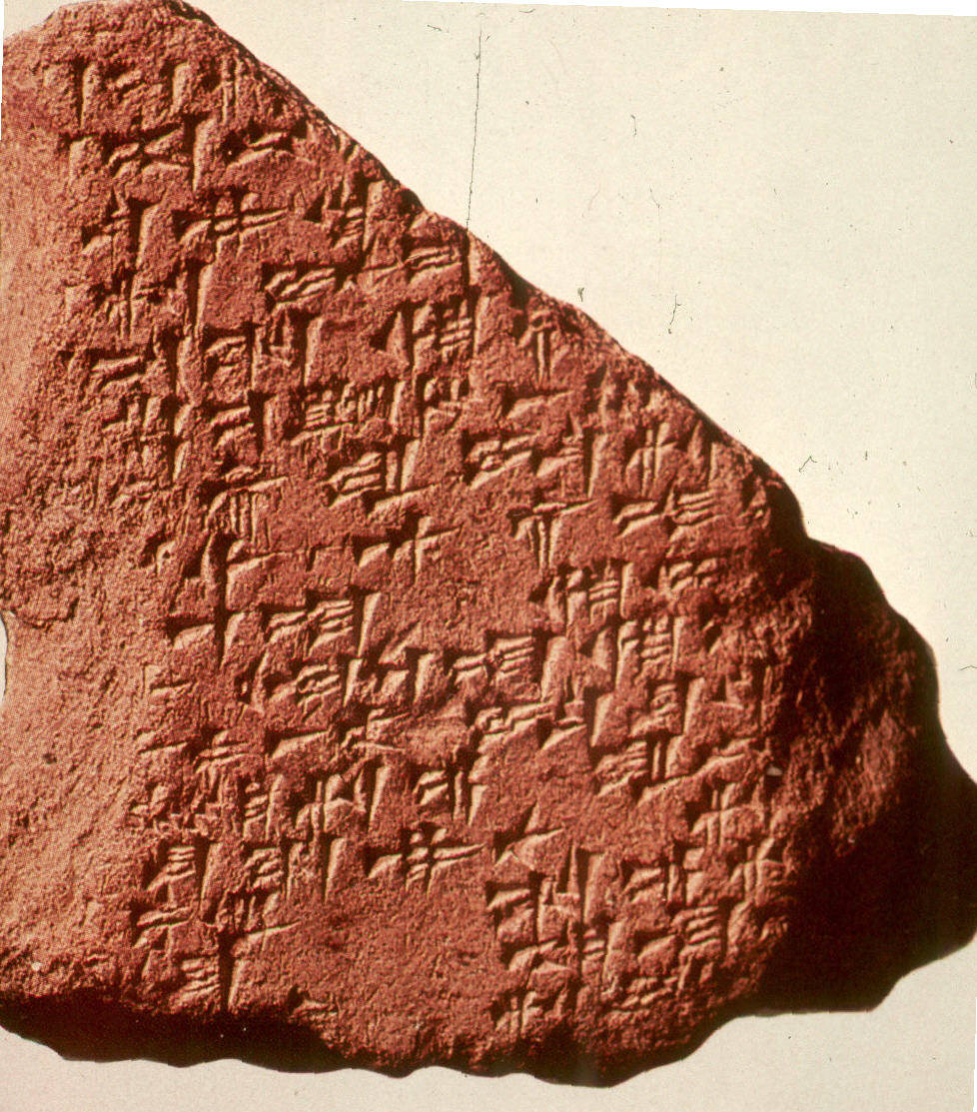
Gilgamesh Tablets

Slide 24
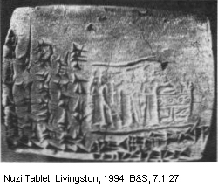
Nuzi Tablets
Assyria
c.1500 BC
primary source of information about everyday life in Northern Mesopotamia in the mid-2nd millennium BC
4,000 tablets

Slide 25
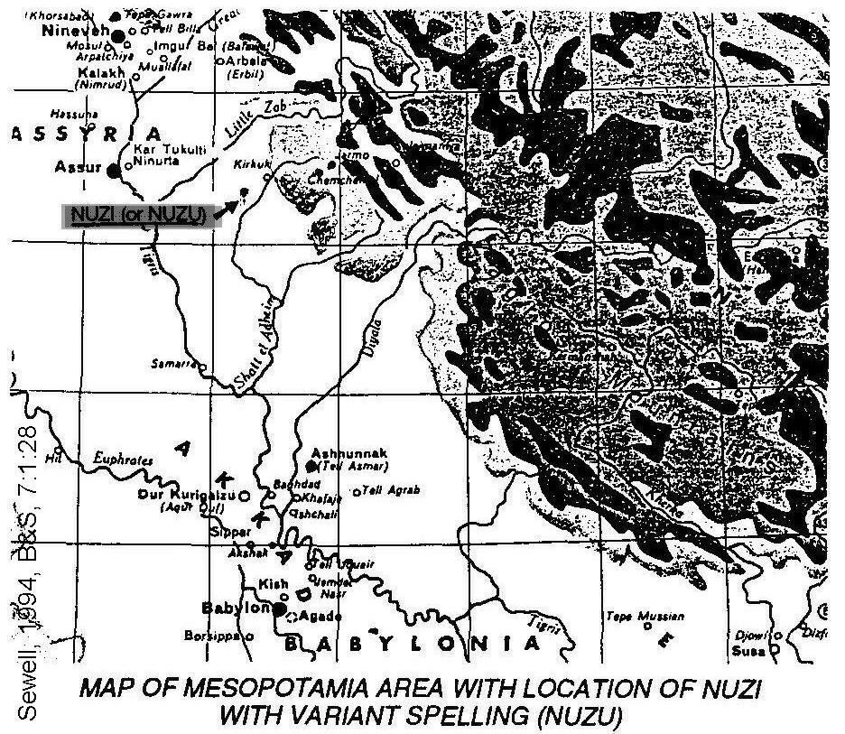

Slide 26
Nuzi Tablets
Nuzi was part of the Hurrian Mitanni empire (Biblical Hurim, Horites or Hurrians)
Was at its height during the 15th-14th centuries BC.

Slide 27
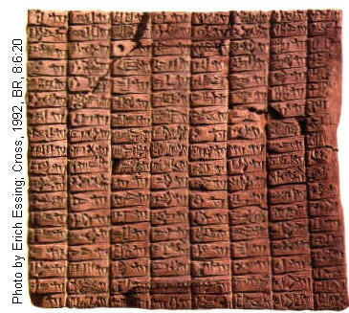
Elba Tablets
15,000 tablets
3000-2400 BC
Many biblical personal and place names
“Urusalem” = Jerusalem mentioned

Slide 28
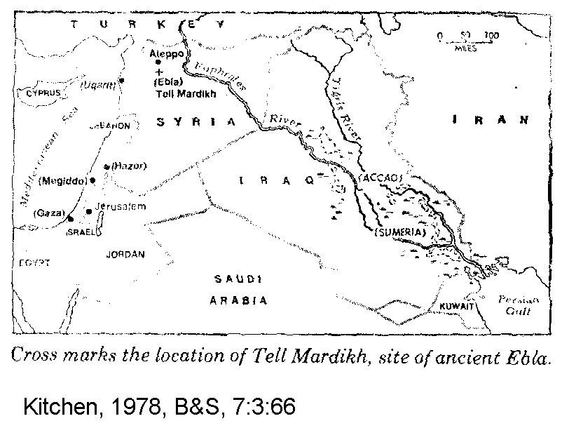

Slide 29
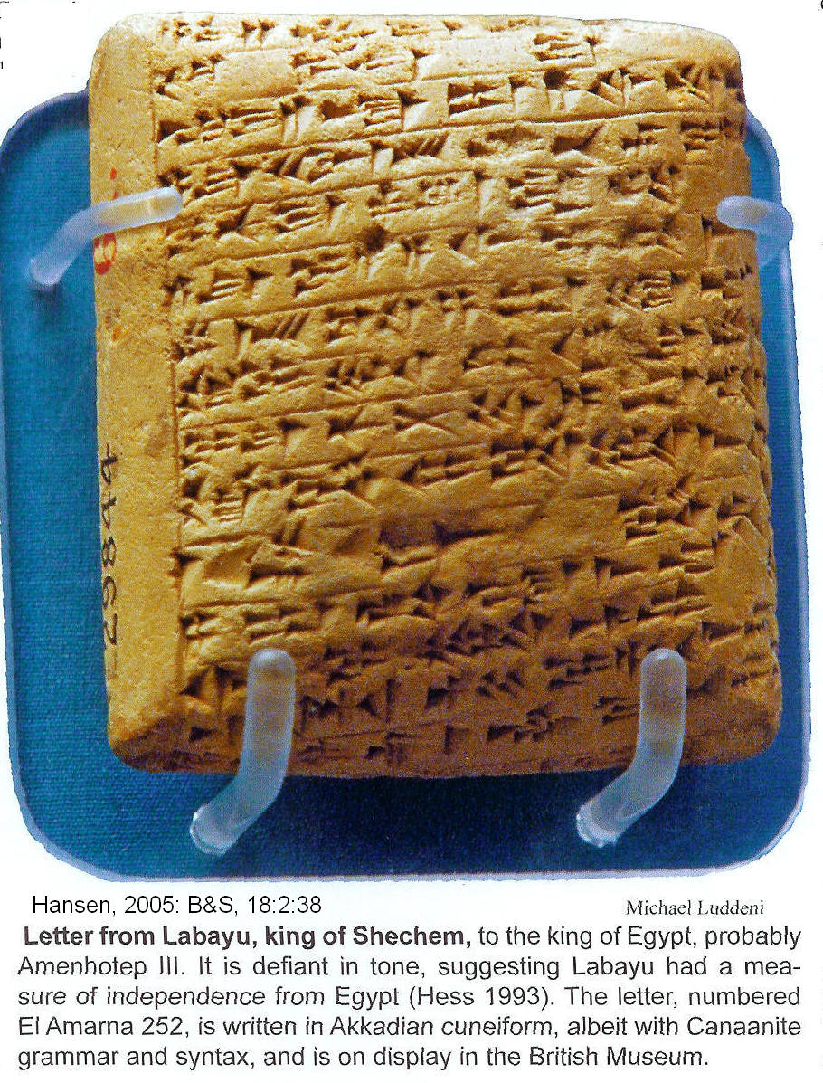
Amarna Tablets
From Egypt
1450-1200 BC
Written during period of Exodus or Judges

Slide 30
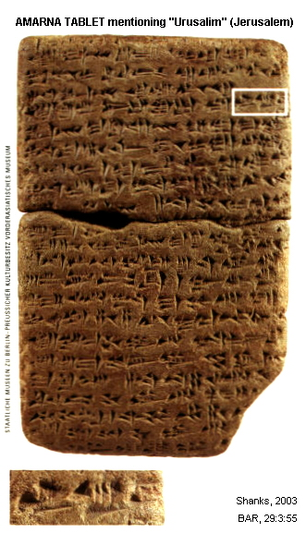
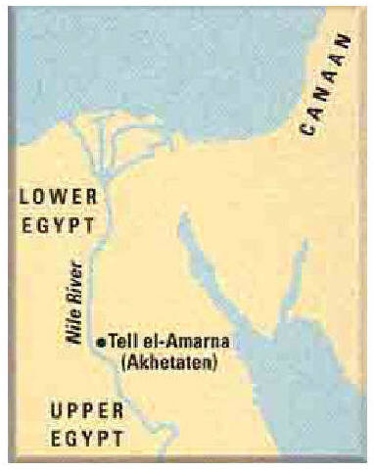
Amarna

Slide 31
Ugarit - Ras Shamrah Tablets
The capital city of the Ugarit Kingdom
Tel (mound) Ras Shamrah
Most prosperous age
1450 to about 1200 BC
Great royal palaces
Temples and shrines
High priests' library
Other libraries on the acropolis

Slide 32
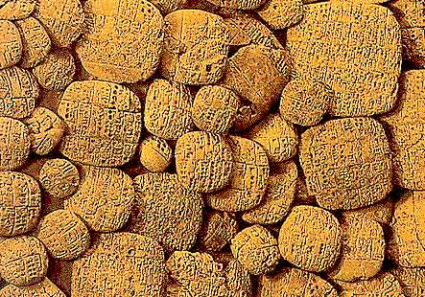
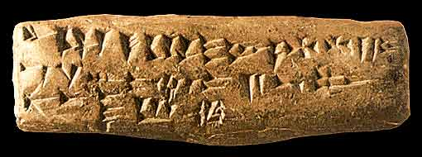
Ugarit
Cuneiform alphabetic script
Mythological and religious literature,
Palatial libraries
Private libraries
Government
archives: political,
social, economic

Slide 33
Alalakh Tablets
Tell Atchana along the lower Orontes River
Present-day southeastern Turkey
18th-15th centuries BC
Describe the changing political and economic situation of a settlement at the margins of the Mitanni and later Hittite states

Slide 34
Boghazkoy Tablets
Hittite capital in what is now Turkey
Occupied in the 2nd millennium BC
Over 10,000 cuneiform tablets
Hittite script from the13th and 14th centuries BC.

Slide 35
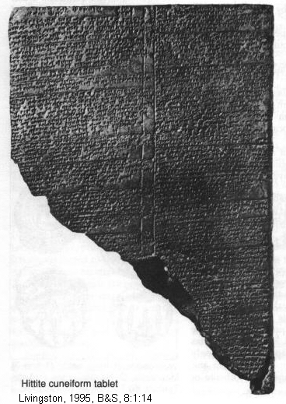
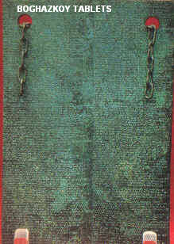
Boghazkoy Tablets

Slide 36
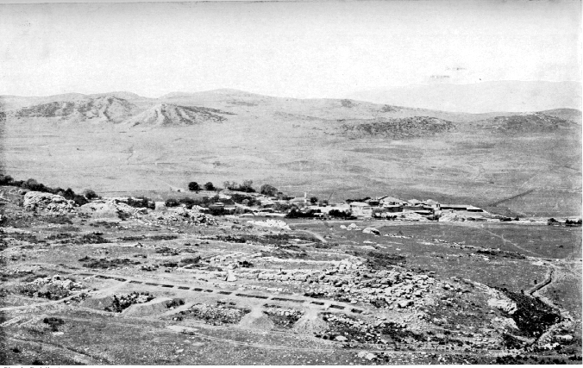
RUINS OF BOGHAZKOY

Slide 37
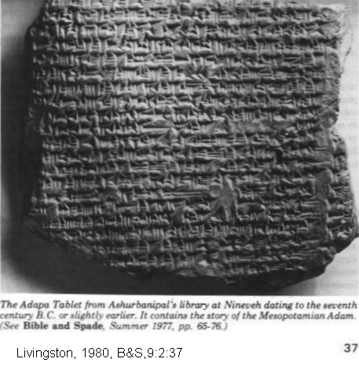
Library of Ashurbanipal: Assyrian Tablets
Library of Ashurbanipal at Nineveh
7th century BC
30,000 tablets
1,200 different texts

Slide 38
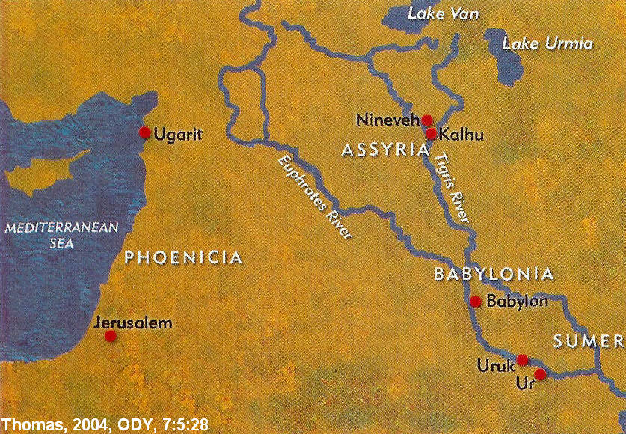
Nineveh: City of Jonah

Slide 39
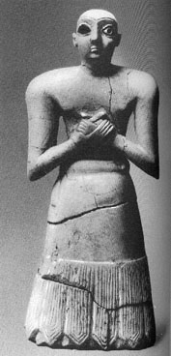
Nippur Tablets
One of the most ancient of all the Babylonian cities
Special seat of the worship of the Sumerian god, Enlil
Founded 5,000 BC
Occupied 5000 BC to 1000 AD
30,000 tablets
Enlil

Slide 40
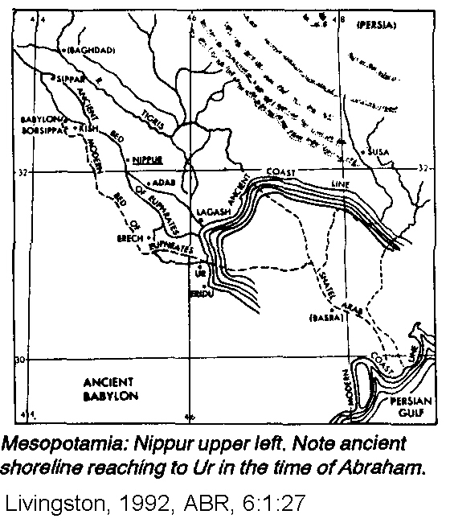
_____

Slide 41
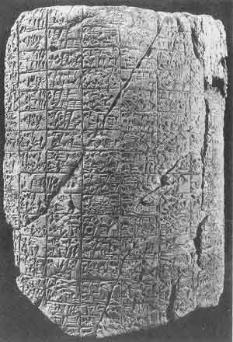
Nippur archaic cylinder, c 2500 BC

Slide 42
DATA SOURCES Patriarchal Narratives
Many sources of documents
Many thousands of tablets
Many different countries and cultures
Many different time periods

Slide 43
HISTORICAL CONTEXT OF THE PATRIARCHAL NARRATIVES
Slaves
Treaties and Covenants
Geo Political Conditions
References to Egypt
Patriarchal Names
Geographic Names
Fort Abram

Slide 44
Slaves and Patriarchal Narratives
The price of slaves
Clues to their time of composition
Measure of historical accuracy

Slide 45
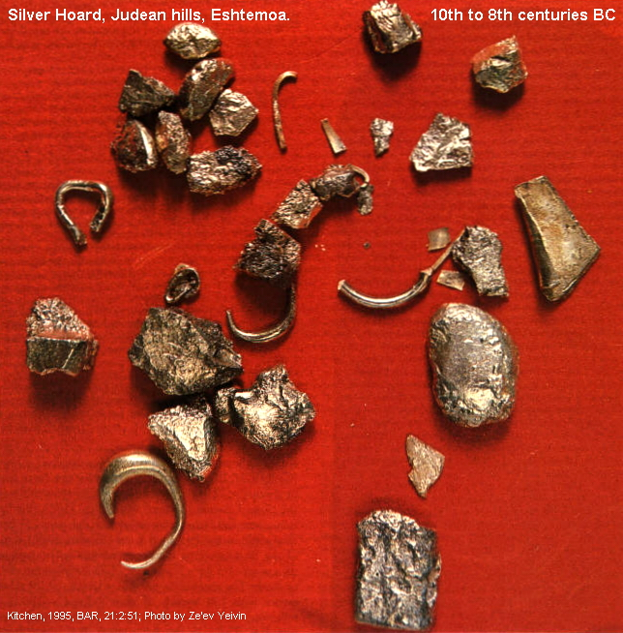
Slave price changes
Economic cirumstances
Political circumstances
Inflation
Use of silver and gold “pieces” as currency
Then, standardized money “shekel”

Slide 46
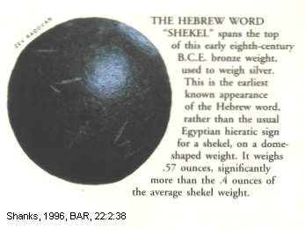
Hebrew Shekel

Slide 47
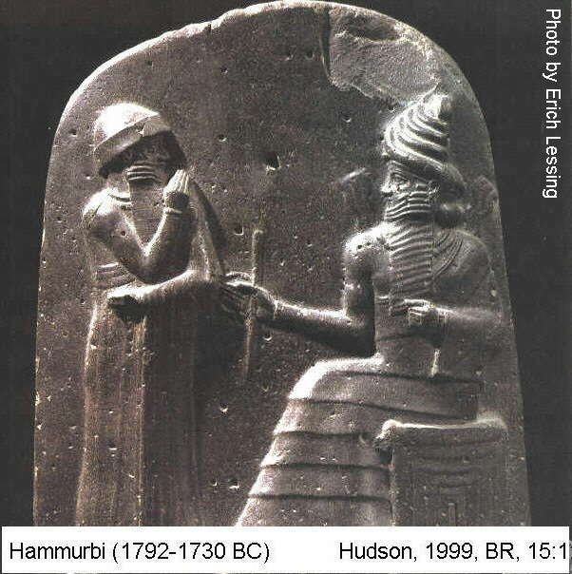
Price of Slaves in Patriarchal Era
20 shekels (Genesis 37:28)
Like that mentioned in the law codes of Hammurabi
Hammurabi was a contemporary of the Patriarchs
Mari tablets and other sources from the 19th and 18th centuries.

Slide 48
Price of Slaves in Mosaic Era
30 shekels of silver (Exodus 21:32)
Reimbursement for a slave killed by an ox
Price of slaves in 14th and 13th century BC Egypt
Price of slaves in contemporaneous Nuzi and Ugarit tablets

Slide 49
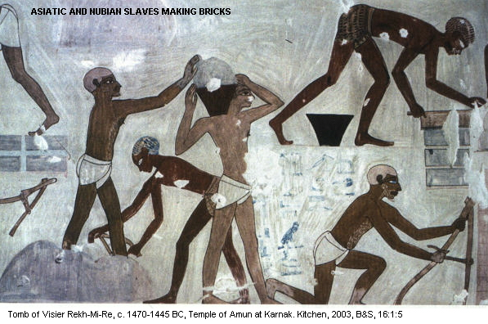

Slide 50
Price of Slaves during the Divided Kingdom
50 shekels of silver (2 Kings 15:20)
In the late 8th century BC
Menahem, king of Israel ransomed Israelites captured by the Assyrian king Pul (Tiglath Pileser)
Assyrian records for this time period also put the price of slaves at 50 to 60 shekels

Slide 51
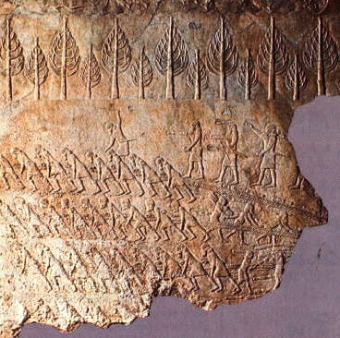
Assyrian slaves

Slide 52
Price of Slaves in the Persian Period
90 and 120 shekels
Fourth and ifth centuries BC
After the Exile

Slide 53
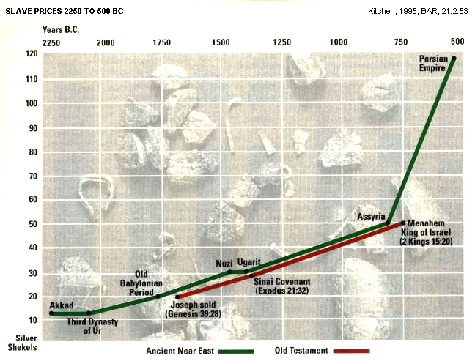

Slide 54
Price of Slaves
Patriarchal Narratives accurately report price of slaves at 20 shekels of silver
If the Narratives where inventions during the Babylonian exile, why weren’t slave prices described with the 4th century BC price of 90-120 shekels?

Slide 55
Treaties and Covenants
Changes in the structure of legal agreements
Give information on historical setting of the Patriarchal narratives

Slide 56
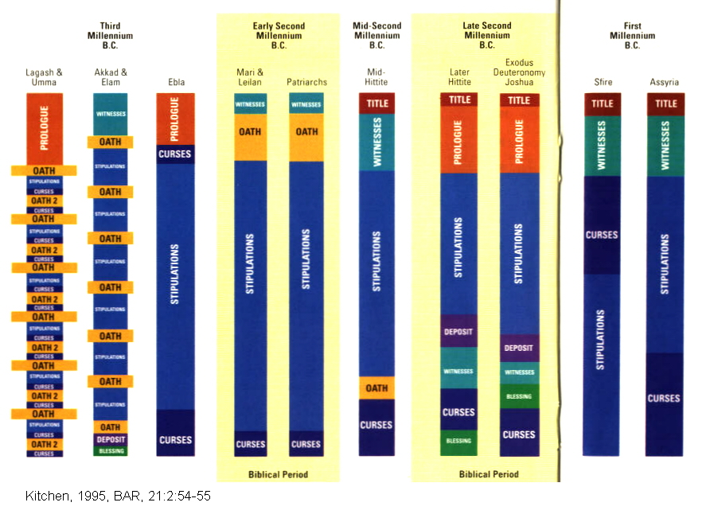

Slide 57
Covenants of the Patriarchal Period 4-fold structure
1. listing of witnesses
2. oath
3. stipulations
4. curses

Slide 58
Mesopotamia
Early second millennium BC
Treaties and legal agreements
Similar form as in the Patriarchal Narratives

Slide 59
Exodus/Conquest Covenants
Mid to Late 2nd millennium BC
7-fold structure
Similar to contemporary late Hittite covenants

Slide 60
7-fold structure Exodus-Conquest period
1. title
2. prolog
3. stipulations
4. deposit
5. witnesses
6. blessings
7. curses
Hittite cuneiform

Slide 61
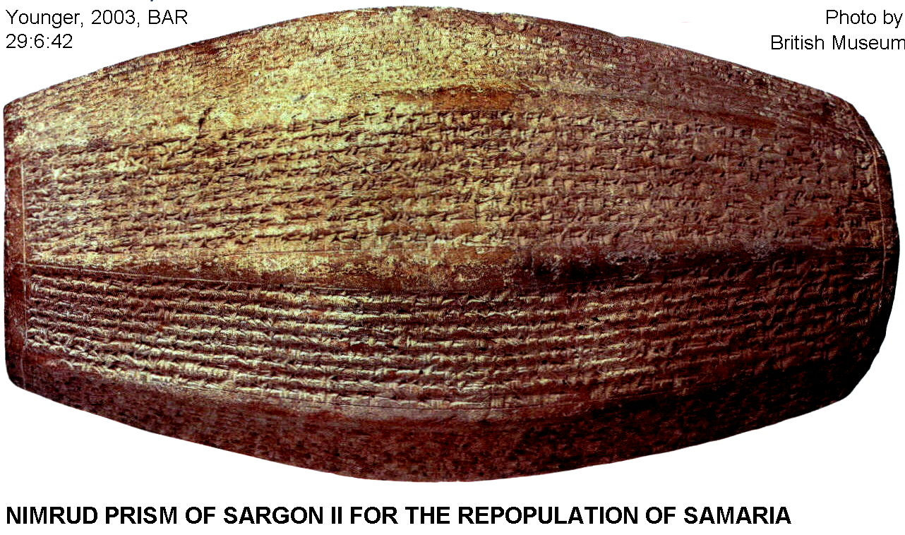
Covenants of the Judges and the United Monarchy
Early first millennium BC
4-fold structure

Slide 62
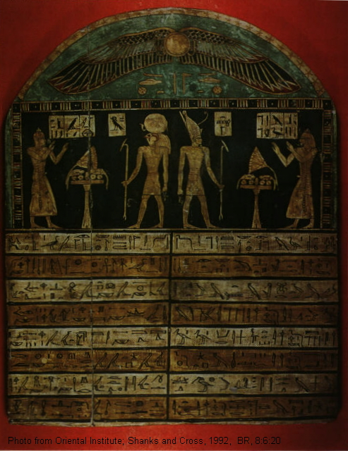
4-fold structure Judges and United Monarchy
1. title
2. witnesses
3. curses
4. stipulations

Slide 64
Structure of Covenants
The structure of the Patriarchal covenants fit in only one period of Near East History, the Middle Bronze age

Slide 65
Special Feature of the Abrahamic Covenant
Ritual of Circumcision
Gen. 17:10-11

Slide 66
Circumcison
The origin and purpose of circumcision are uncertain.
The oldest known description of the practice is from the stela of Naga-ed-Dar dated to 2130-1940 BC from the Middle Kingdom of Egypt.

Slide 67
Stela of Naga-ed-Dar
A group ceremony is involved (King, 2006:47):
“[When] I was circumcised (sab) [?] with 120 men and there was non whom I struck and none who struck me among them”

Slide 68
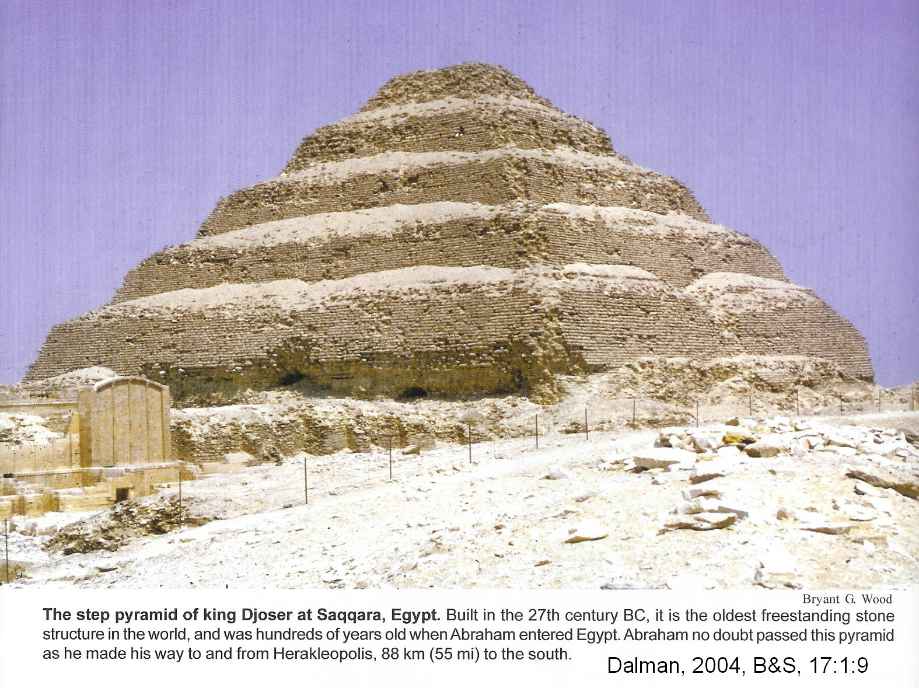
Relief from the tomb of the “royal architect” Ankh-ma-hor at Saqqara

Slide 69
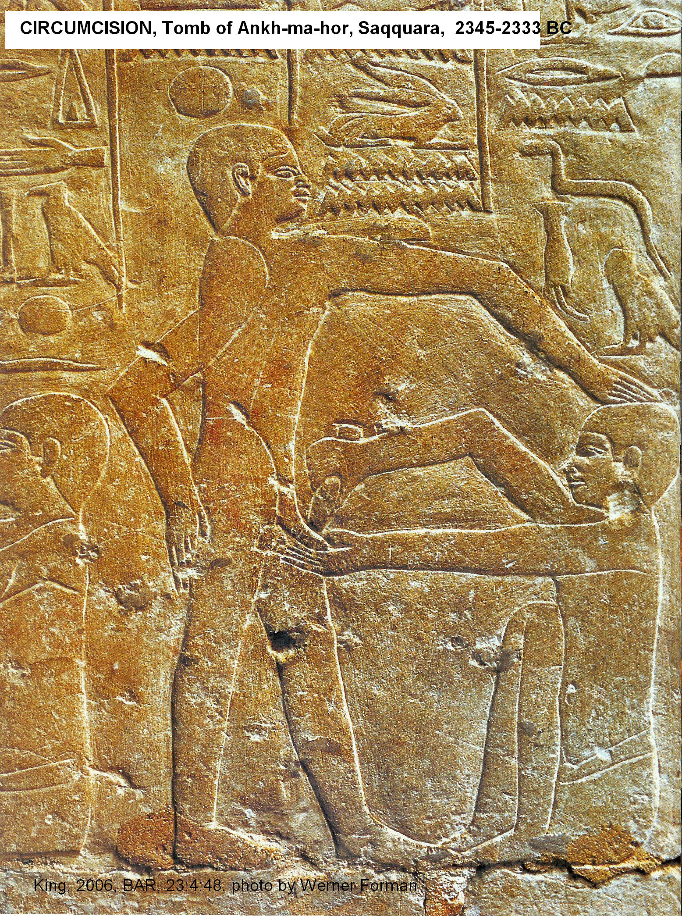
Mortuary priest is squatting before a youth to administer the circumcision

Slide 70
The Ebers Papyrus
Written in hieratic (cursive) Egyptian script dating to about 1550 BC.
It is considered to be the most significant medical record from Egypt and contains a remedy for the bleeding caused by circumcision:
“dzja [unknown], honey, cuttle-bone, sycamore, fruit of dzja [unknown] are mixed together and applied thereto”

Slide 71
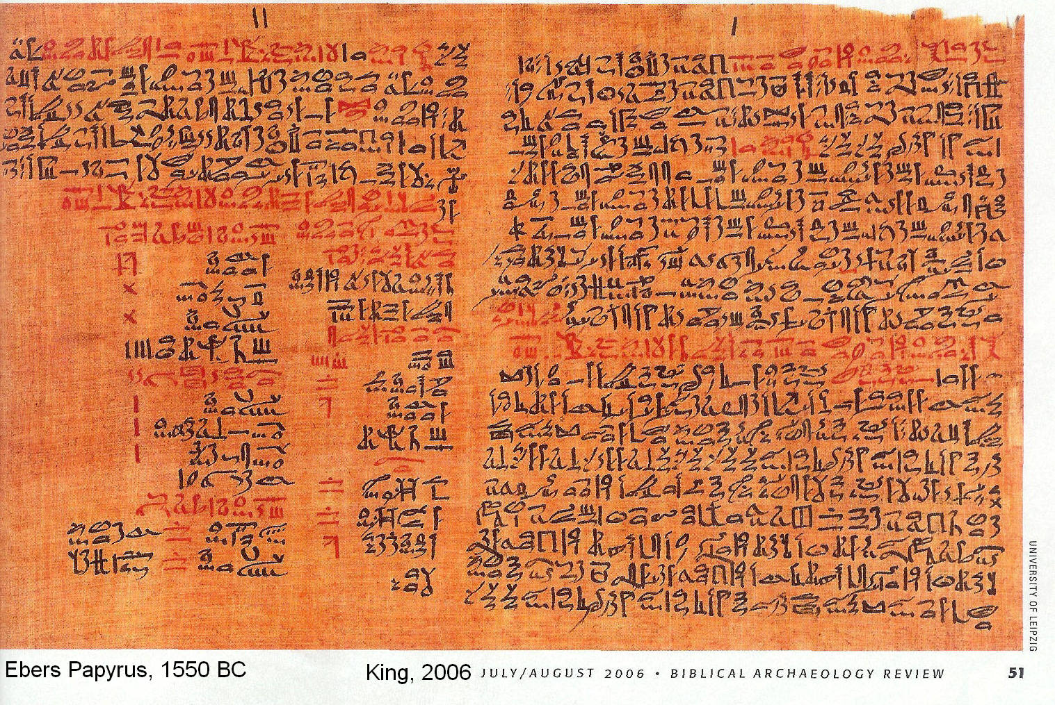

Slide 72
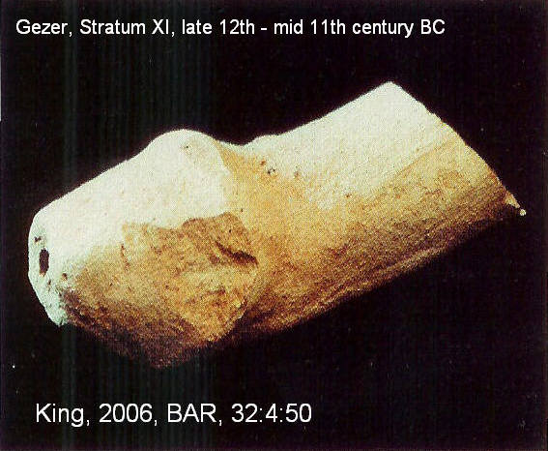
Canaanites at Gezer
Practiced circumcision
Inch-long, 0.4 inch wide broken terra-cotta phallus.
Excavated from Stratum XI
Dates to the late 12th – mid 11th century BC

Slide 73
Assyrian Sennacherib
Conquered the Israelite town of Lachich,
Oordered a series of reliefs made at his palace in Nineveh to commemorate the victory.
Depictions of naked Israelites impaled on poles.

Slide 74
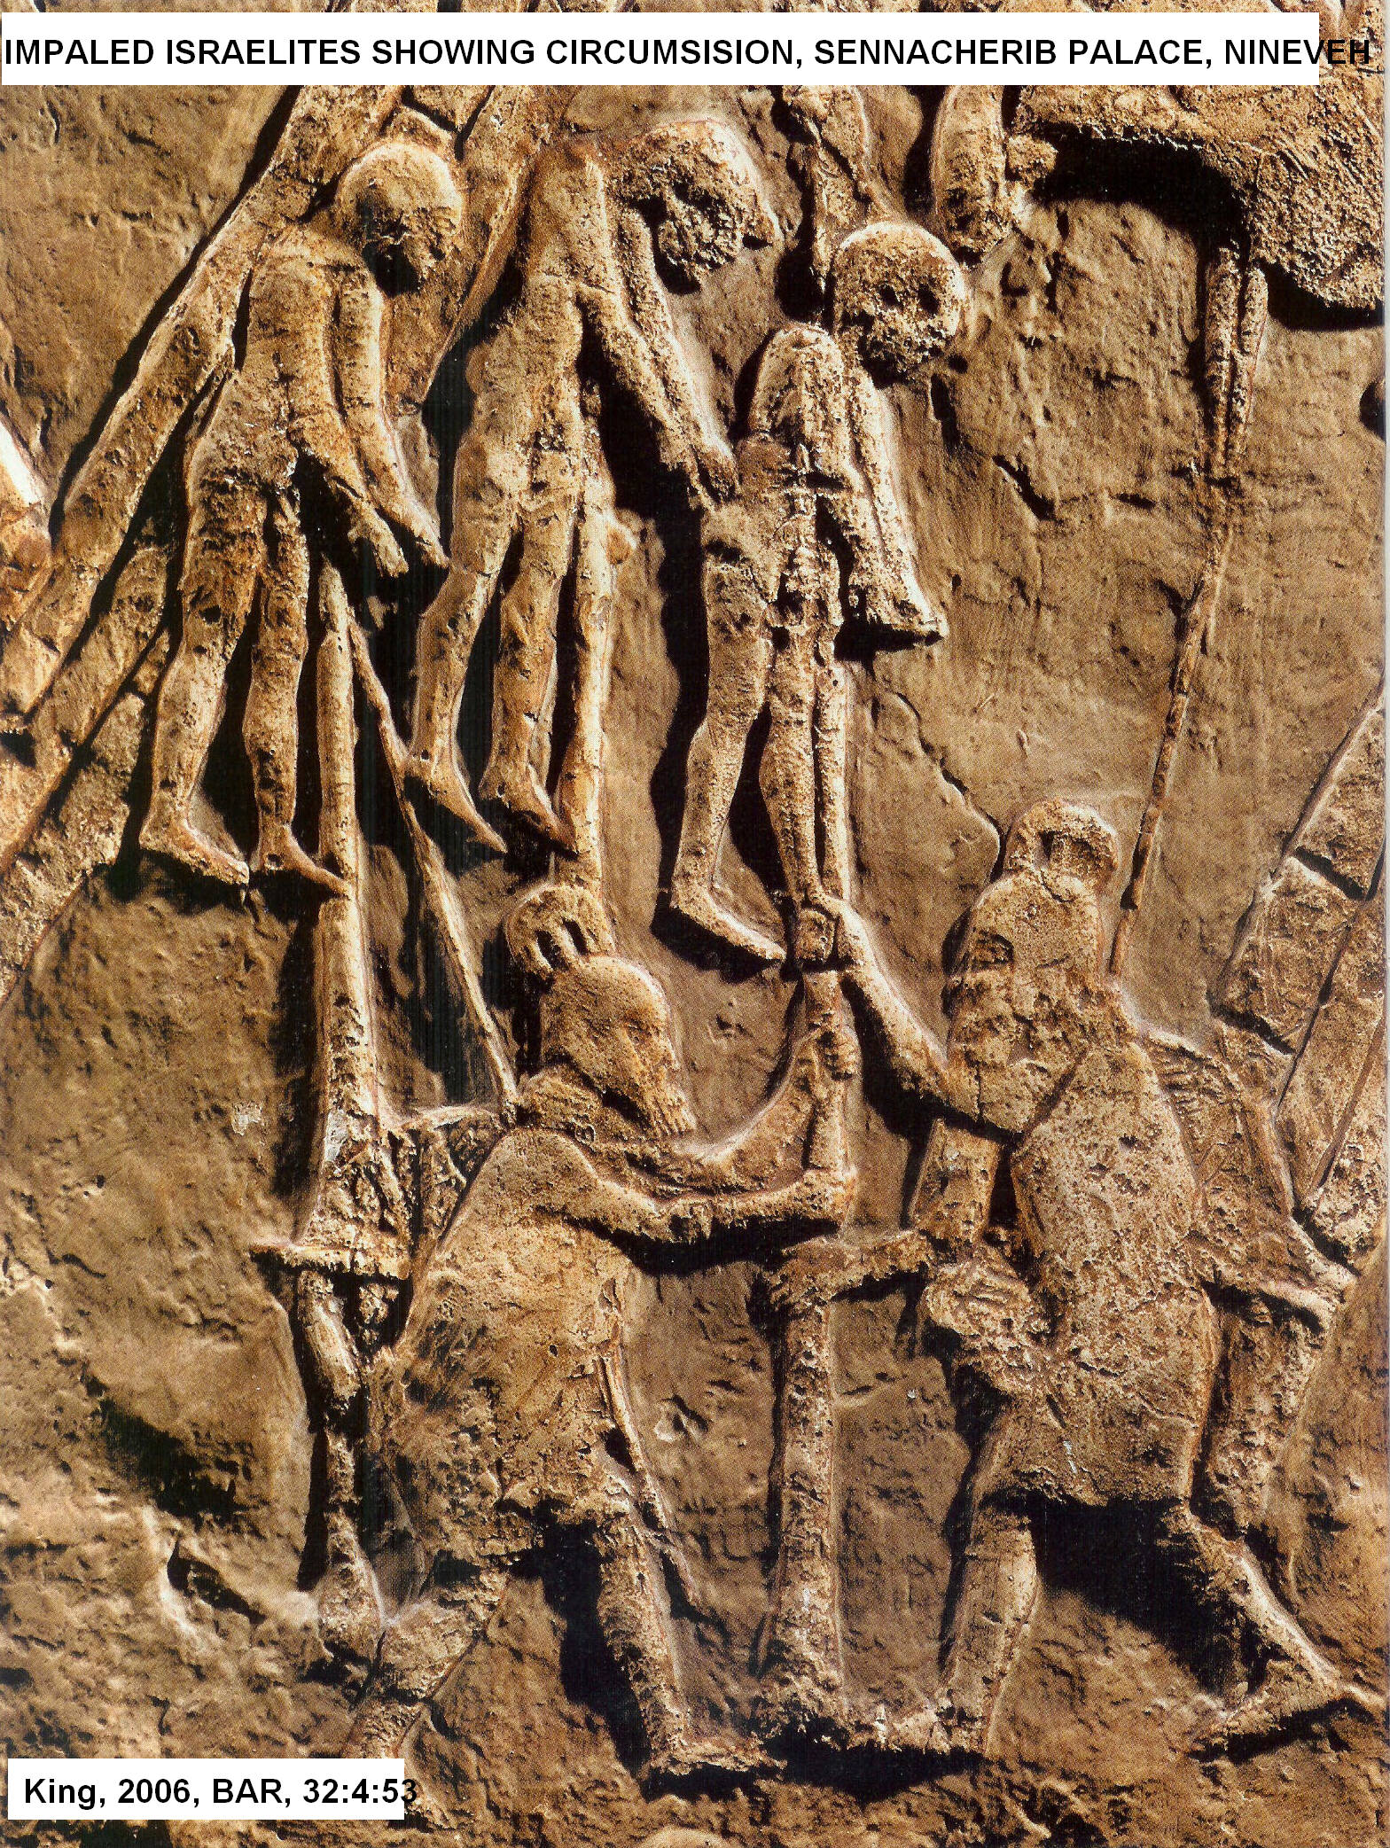
Detailed examination of these reliefs indicates that the Israelites are circumcised with the entire prepuce removed and the entire glans exposed

Slide 75
Circumcision or No
Western Semitic Circumcision
Canaanites
Ammonites
Moabites
Edomites
Phoenicians
Arameans
Eastern Semitic No Circumcision
Mesopotamians
Akkadians
Assyrians
Babylonians

Slide 76
Sea Peoples
Practiced Circumcision
Ekwes
Sheklesh
Sherdani,
No Circumcision
Philistines

Slide 77
Geo Political Conditions
The associations of petty kings described in Genesis 14
Fit the geo-political landscape of the early 2nd millennium BC Near East

Slide 78
Historical Context of Genesis 14
Must have occurred before the 12th century BC
After that time the Philistine league and early Israel emerged
Egypt was the dominant force in the west in the 15th to 13th centuries BC
Time when great powers (Egypt, Mesopotamia, Hittites) were weak

Slide 79
Historical Context of Genesis 14
Inscription of Iahdum-Lim of Mari
Military alliance similar to that described in Genesis 14:1-11 but from the Mari point of view.

Slide 80
Historical Context of Genesis 14
After the 18th century BC, the rise of Babylonia under Hammurabi and the rise of Assyria under Adad I marked an end to city-state alliances in Mesopotamia.

Slide 81
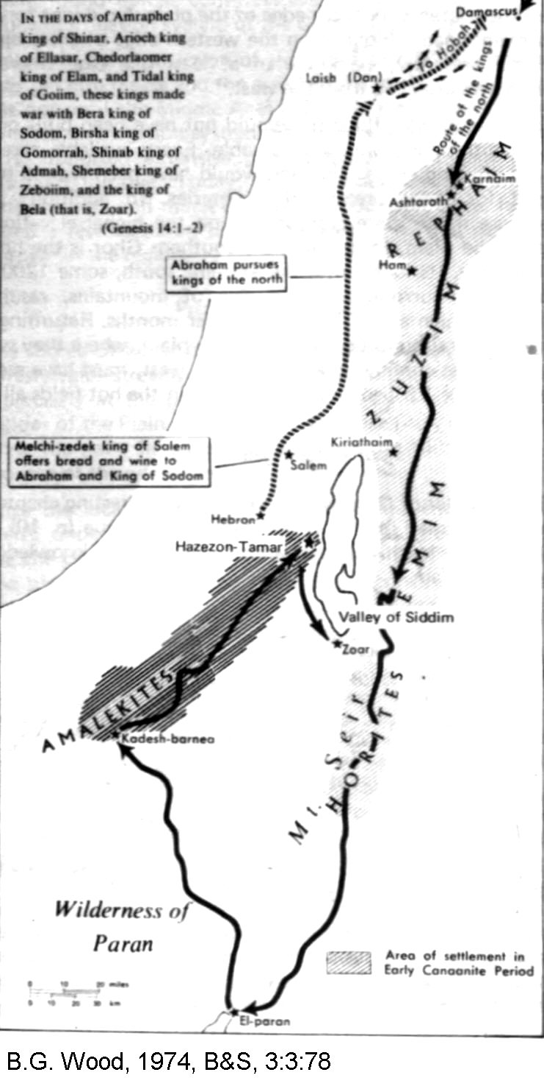

Slide 82
Historical Context of Genesis 14
These shifts and consolidations of authority suggest that the conditions described in Genesis 14 belong to the period of anarchy and absence of empire in the Levant in the early second millennium BC
The Abraham Narrative is not a fiction of the Exile period

Slide 83
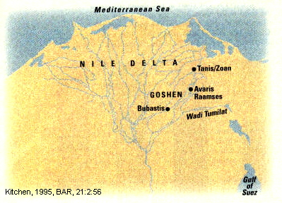
References to Egypt in the Patriarchal Narratives
Both Abraham (Gen. 12:10-20) and Jacob (Gen. 45:28-47:28) interact with Egyptian pharaohs on the eastern side of the Nile Delta

Slide 84
References to Egypt in the Patriarchal Narratives
During in Dynasties XII and XIII (20th to 17th centuries BC), palaces and temples were built in the eastern delta.
The Hyksos invader pharaohs (17th to 16th centuries BC; c. 1648-1540 BC) also had interest in the eastern delta and made a summer capital at Aravis

Slide 85
References to Egypt in the Patriarchal Narratives
When the Hyksos were expelled, native Egyptians took command again in Dynasty XVIII (1539-1292 BC). They moved their capital to Memphis and abandoned the delta
Dynasty XIX (1292-1190 BC) originated in the eastern delta and moved the capital to Pi-Ramesse under Rameses II (1279-1213 BC)

Slide 86
References to Egypt in the Patriarchal Narratives
In Dynasty XX (1190-1075 BC) under Pharaoh Rameses IV (1145-1137 BC), Pi-Ramesses was abandoned and used as a stone quarry

Slide 87
Fortress of Abraham
The oldest reference to a Biblical Patriarch is found in the victory stela of Pharaoh Sheshonq I (Biblicall Shishak, 931-910 BC) at the Temple of Amun at Thebes.

Slide 88
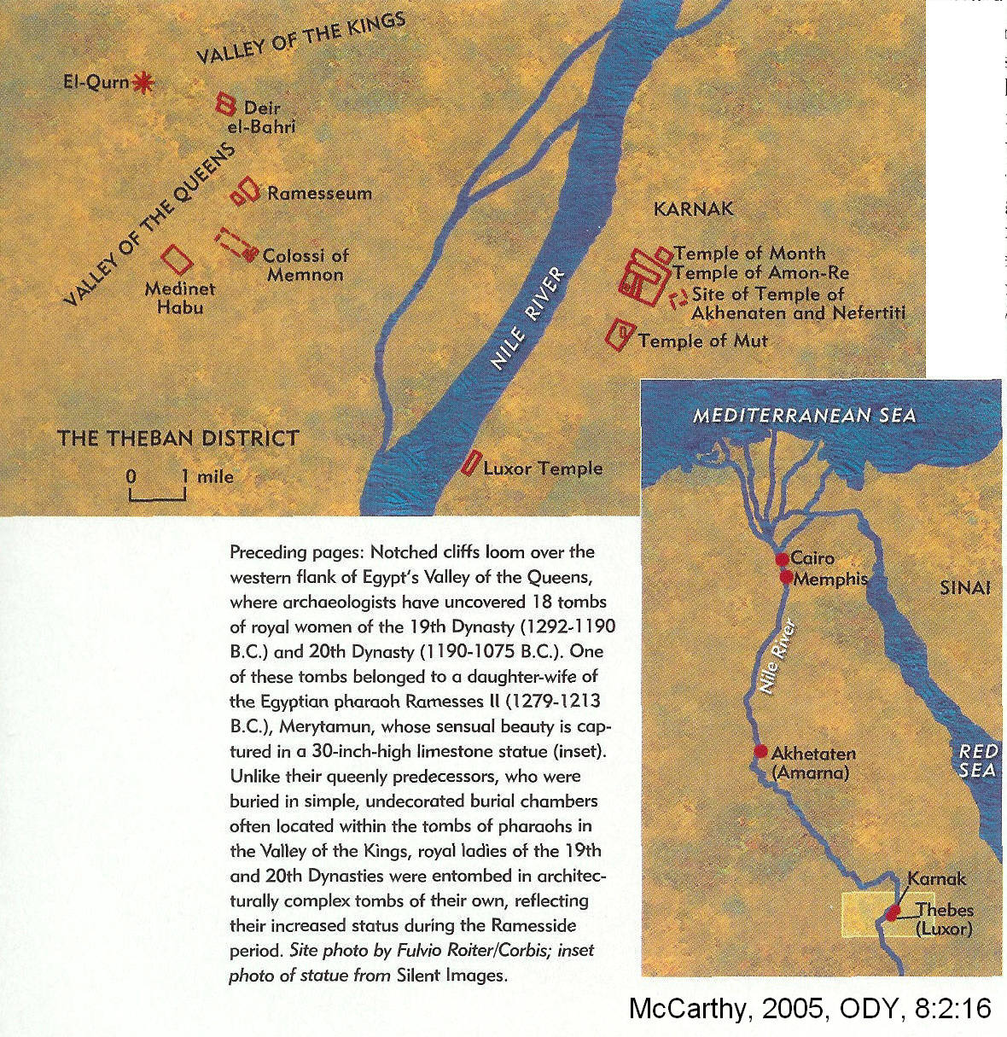

Slide 89
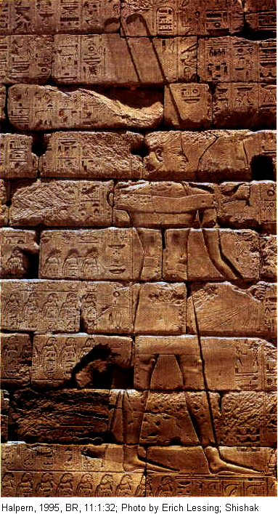
Victory Stele, Shesonq I, Expedition into the Levant, 925 BC
On list of destroyed places: “Fort Abraham”

Slide 90
Significance of Fort Abraham
The Abraham tradition has to extend back at least to the time of David.
The Abraham-Patriarchal tradition is not just an invention of the Exile

Slide 91
Egyptian Summary
Social Development
Eastern Delta Developed: Dynasties XII to XIII
Eastern Delta Developed: Hyksos Invasion
Delta Abandoned: Dynasty XVIII
Eastern Delta Re-Developed: Dynasty XIX
Eastern Delta Abandoned: Dynasty XX, Rameses IV
Date
20th to 17th centuries BC (Abraham)
17th to 16th centuries BC
15th to 14th centuries BC
12th to 13th centuries BC (Jacob and Exodus, late date)
12th century BC, 1145-1137 BC

Slide 92
Significance
The Patriarchal stories place the Patriarchs in Egypt during a time when large population centers had developed.
The Exodus stories are also set in a time when the eastern delta was populated.
How could both epochs of biblical history be so accurate if the events are fabrications of the Exile?

Slide 93
Patriarchal Names
Marked difference between the Patriarchal names of Genesis and those found later in Exodus and later Biblical history

Slide 94
Patriarchal Names
In Genesis, names are dominated by the god-name “El” (e.g. Ishmael, Israel, Bethuel)
No Genesis patriarchs with the divine name “Yahweh” (-ya endings or ye- beginnings)
Yahwistic names are not found until Exodus (i.e. Yehoshua [Joshua]
The god of the Patriarchs was El who was also the high god of the Canaanite pantheon

Slide 95
Patriarchal Names
“the patriarchal names is historically accurate: The tradition accurately remembered (as evidenced by the names in the patriarchal narratives) that there was a period sometime in the second millennium B.C.E. when there was an El religion. The people who venerated El apparently later became part of Israel (another El-name). In other words, the El religion of the patriarchs preserves authentic pre-Yahwistic historical memories” Hendel, 1995
Patriarchal traditions are not inventions of the Babylonian Exile

Slide 96
Geographical Names Amorite to Aramean Names
The Patriarchal homeland for Abraham’s kin is the region of Syro-Mesopotamia between the Euphrates and Habur rivers.
Many of his relatives have personal names that correspond to place-names in this region (e.g. Segur, Nahor, Terah).
This region, after the 11th century BC. was occupied by the hated Arameans, who were enemies of Israel for most of their history.

Slide 97
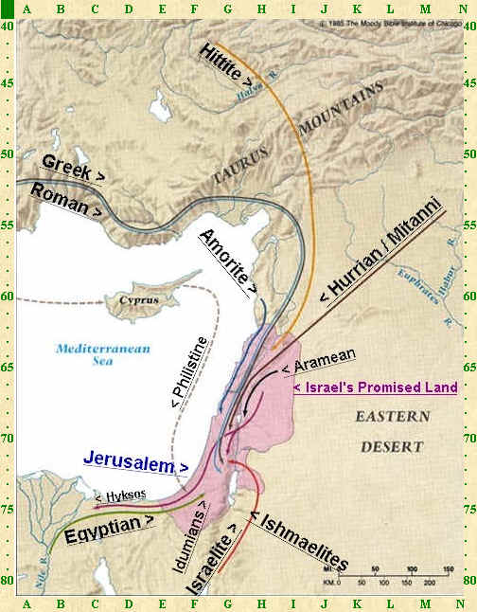
Euphrates and Habur Rivers at M-60

Slide 98
Abraham the “wandering Aramean”
There are several Aramean-based place names in Genesis (Aram-Naharaim, “Aram of the two Rivers”, Gen. 24:10; Paddan-Aram, “Plain of Aram”. Gen. 28:6-7).
An Aramean connection is also indicated by Deut. 26:5 “My father was a wandering (or perishing) Aramean”

Slide 99
Solution: Old Amorite Names replaced by newer Aramean ones
The region later occupied by Arameans was occupied by Amorites during the Patriarchal Age (Bronze Age, second millennium BC).
This follows the historical connection between the patriarchal traditions and the Amorite cultures of Syro-Mesopotamian during the Middle and Late Bronze Ages

Slide 100
Why Aramean names?
Aram-Naharaim
Paddan-Aram
Segur
Nahor
Terah

Slide 101
Solution
Amorite names were replaced Aramean ones by editors of the Hebrew Epic
When the tradition was edited, during the first millennium BC (1004 to 567 BC), the second millennium BC traditions were updated to reflect the then-current geographical and ethnic conditions

Slide 102
Solution
Thus the patriarchs of the 21’s century BC became “wandering” Arameans of the 11th century BC

Slide 103
Paleoclimatology of the Patriarchal Age
300-year drought between 2300 and 2100 BC.
Resulted in:

Slide 104
NEXT TIME
Paleoclimatology of the Patriarchal Age

Slide 105
Archaeology and the Old Testament
Chapter 11: The Patriarchal Narratives: Part 2
Dr. Gregg Wilkerson

Slide 106
Paleoclimatology of the Patriarchal Age
300-year drought between 2300 and 2100 BC.
Nations rise and fall according to broad geologic conditions that influence food production
Drought Resulted in:

Slide 107
Warming Period and Drought End of Early Bronze Age
Egypt: First Intermediate Period
Western Mesopotamia: abandonment of many sites across the Habur river valley and the Assyrian plains
Levant:, end of the Early Bronze (EB) Age culture: "non-urban interlude" between the EB and Middle Bronze Age

Slide 108
Climate Change and Abraham
The partriachal age began with the call of Abraham in 2090 BC at the end of Early Bronze Age warm period and associated famine.

Slide 109
HURRIANS AND THE PATRIARCHS: HARAN
Recurrent base of operations for the Patriarchs and was part of Hurrian Mitanni Empire.

Slide 110
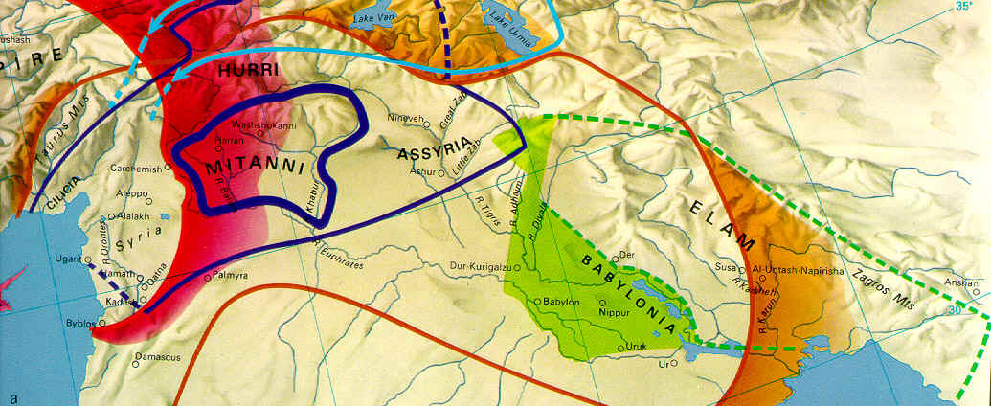

Slide 111
Patriarchs and Haran
Tera and Abraham's original home after they migrated from Ur.
Abraham sent his son Isaac back there to get a bride (Genesis 24:2-10)
Jacob fled to his uncle Laban in Haran to avoid Esau's wrath (Genesis 27:43).
Jacob married his cousins Leah and Rachel there (Genesis 29:1-30;

Slide 112
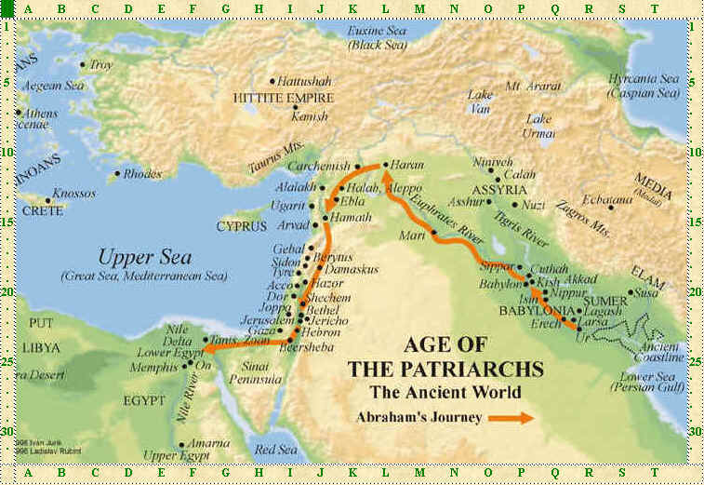

Slide 113
Patriarchs and Cities
They did not generally live in cities, but set their camps near them
Nomads, not farmers or urbanites
18th-16th centuries BC
First Intermediate (Hyksos) period in Egypt

Slide 114
Examples of early Patriarchal city: Beth Shean, Megiddo

Slide 115
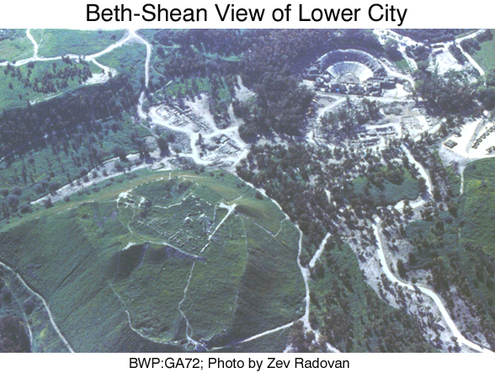

Slide 116
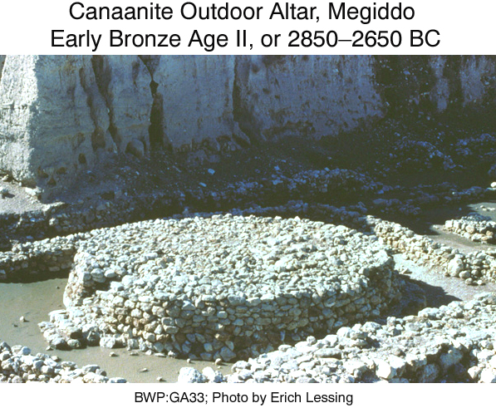

Slide 117
Patriarchs and Cities
When they did live in cities
They were generally unwalled
Not fortified settlements

Slide 118
Patriarchs and their Unfortiried Cities
camps
unwalled villages
a walled town with gates and bars
open towns
Numbers 13:19
1 Samuel 6:18
1 Samuel 23:7
Esther 9:18

Slide 119
ABRAHAM THE CARAVANEER (2164-1990 BC; MB1)
Dates debated
Middle Bronze Age Palestine

Slide 120
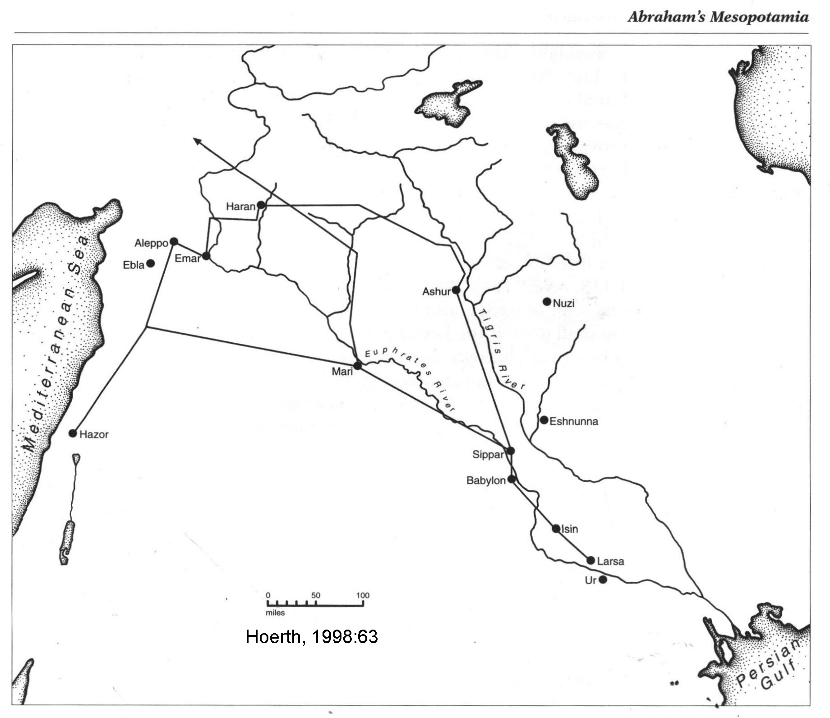

Slide 121
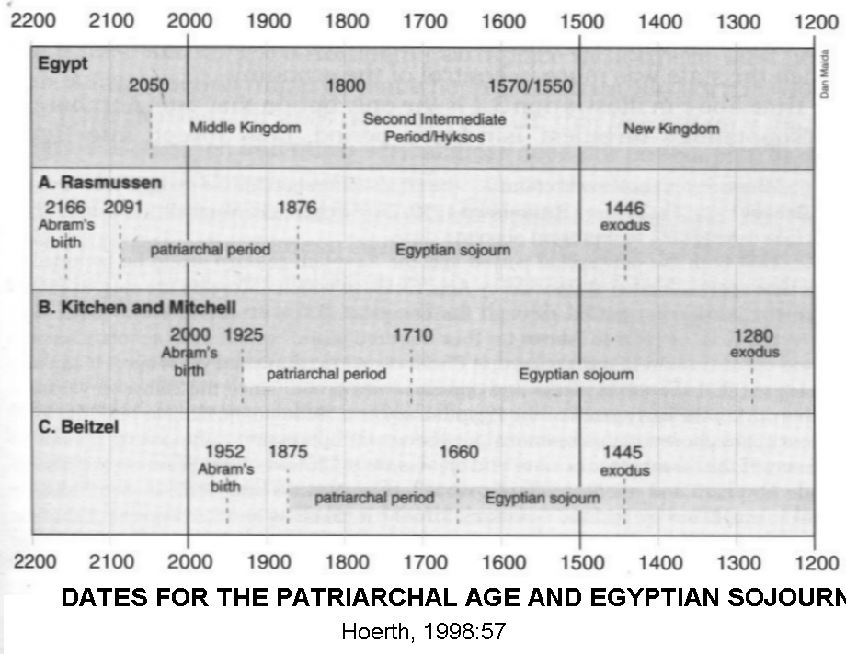

Slide 122
Abraham: Middle Bronze Age
Period of several small settlements
Small simple stone houses
Temporary quarters for nomadic tribes working along trade routes

Slide 127
Abraham: Middle Bronze Age
Ur and Haran were flourishing
Jordan Valley populated
Sparse population in the Hill Country
In the Negev, there was settlement from the 21st to the 19th centuries BC, but not before or afterwards

Slide 128
Abraham: Middle Bronze Age
Abraham moved freely between Shechem and Beersheba (no fortified, restriced borders)
Open for Isaac and Jacob too
During the 19th century BC the cities west of the Jordan were again occupied
Asiatics (including Abraham) enter Egyptian Delta without opposition

Slide 129
Abraham: Similar to Bedoin

Slide 132
Politics and Social Structures of Mesopotamia in Abraham's Time
During the Ur III Dynasty which fell in 2004 BC.

Slide 133
UR III EMPIRE

Slide 134
Abraham: Middle Bronze Age
Following the collapse of Ur III civilization
Isin-Larsa period
Several small kingdoms which competed among themselves for control and influence
Most important new kingdom: Larsa
20 miles northeast and on the opposite side of the Euphrates river from Ur

Slide 135
--------------------------------
LARSA

Slide 136
Abraham, Middle Bronze Age
Civil Wars in Mesopotamia
End of Sumerian Renaissance
Invasion of Amorites
No wheat growing in southern Mesopotamia
Barley yield was declining
Terah moves family to Haran

Slide 137
Abraham, Middle Bronze Age
Semitic Akkadian dynasty; Ishin-Larsa Period (2334-2193)
Early experiments in free enterprise and private property were expanded in Mesopotamia during the Isin-Larsa period

Slide 138
Abraham the Cavneer
Merchants and caravaneers to gain economic and social prominence
Become co-equals with the petty kings they "supported“
Economic and political power was no longer in the hands of king and priest
Precisely the picture of Abraham painted in Genesis

Slide 139
Lipit-Istar Code and Laws of Eshnumunna of the Ishin-Larsa Period
ANE 1:138; ANET 163
If an ox is known to gore habitually and the authorities have brought the fact to the knowledge of its owner, but he does not have his ox dehorned, it gores a man and causes his death, then the ower of the ox shall pay two-thirds of a mina (1/50th of a shekel) of silver
Exodus 21:39
If, however, an ox was previously in the habit of goring, and its owner has been warned, yet he does not confine it, and it kills a man or a woman, the ox shall be stoned and its owner also shall be put to death

Slide 140
Mesopotamian Religion in Abraham's Time
hyper-polytheistic
4,000 deities
National, City, Crossroads, Family
Chief national deity: Anu
In Isin-Larsa period, Anu’s functions were replaced by his son Enlil

Slide 141
ENLIL, SON OF ANU

Slide 142
Ea: Brother of Enlil
god of wisdom ("Lord of the intelligent eye")
Champion for humans
Patron god of artists, craftsman, scientists, magicians and literature

Slide 143
Sin: moon god
The old moon god was Nanna
His name was changed in the Isin-Larsa period to Sin
Second in command to Ea
Controlled the night, month and calendar
Represented the "dark side" of deity
Could read the dark future and reveal destinies for people

Slide 144
Marduk: Sun god
god of magic
Originally in the second rank of gods
Marduk rose to prominence by assimilating the duties of Enlil
Replaced Anu as chief god in the pantheon

Slide 145
Nabu: god of wisdom
Son of Marduk
god of scribal arts
Junior sun-god
Represented the "light side" of deity
Could dispel darkness, see all activities of nature, men and gods, and judged both living and dead

Slide 146
Ishtar: Primary Female Deity
Daughter of Nanna-Sin
Became the most important female deity in Mesopotamian pantheon
Functions were later transfered to Asherah and Astarte
goddess of war and fertility
Later stripped of warrior role

Slide 147
Ishtar on cylinder seal

Slide 149
Mesopotamian religion in Middle Bronze Age of Abraham
Very complex theology
gods having very specialized functions and genealogical relationships to other gods
Proliferation lead to a bureaucratic priesthood and rituals that extended from temple to home
. The gods received daily food offerings, both in institutional and domestic settings. Ritual prostitution insured a source of money for the religious institutions

Slide 150
Mesopotamian religion in Middle Bronze Age of Abraham
gods received daily food offerings, both in institutional and domestic settings
Ritual prostitution insured a source of money for the religious institutions

Slide 151
Mesopotamian religion in Middle Bronze Age of Abraham
Witchcraft
Demons
Bad Omens
Dreams

Slide 152
Mesopotamian religion in Middle Bronze Age of Abraham
Elaborate compilations of omens and dreams
Ritualistic remedies for each omen and dream

Slide 153
Mesopotamian religion and names of God in Abraham’s time
a. Yahweh (Gen 12:1), the common designation when specifically named and the special revelatory name of the covenant
b. Elohim, lit "the totality of the Gods",or "the Supreme God" is the common generic term for God
c. Adoni = "Lord", used occasionally

Slide 154
Mesopotamian religion and names of God in Abraham’s time
three Canaanite terms for God meaning "Creator" [of heaven and earth] but later expanded to include concepts of God as "Provider" and "Redeemer." The Canaanite terms are:
1) El-Elyon (Genesis 14:19) “God Most High”
2) El-Shaddai (Genesis 17:1) “God Almighty”
3) El-Olam (Genesis 21:33) “The Eternal God”

Slide 155
Mesopotamian religion and names of God in Abraham’s time
Abraham grew up in a Middle Bronze Age culture of rampant polytheism

Slide 156
Abraham: Middle Bronze Age
Fits well into the framework of Middle Bronze Age I caravaneer culture
Essentially contemporaneous with Middle Bronze Age I
No signs of patriarchal culture in later history and the religion of Israel except the ritual of circumcision

Slide 157
Abraham’s Ur
Terah, Abraham's father, in Genesis 11:31 is described as a high government official of Ur or international businessman
Ur was great business center and an important trade route ran up the Euphrates and Balik rivers to Haran

Slide 158
“Ur of the Chaldeans”
Gen 11:28, 31; 15:7; Neh 9:7 and Acts 7:2-4.
Editorial scribal “gloss”
"Chaldeans" is the name of a culture at the site of Ur in the 4th century
Glosses like this are used to argue that the patriarchal narratives were composed during the Exile

Slide 159
Ur: Northern or Southern
Southern Ur: Sir Leonard Wooley (1922 to 1934)
Northern Ur: Cyrus Gordon (2000)

Slide 160
Move to Haran: Long or Short move?

Slide 161
Northern Ur
Ur III Period
Southern Turkey, near the Syrian boarder at Ura (northeast of Haran) or Urfa (north-northwest of Haran)

Slide 162
Southern Ur
Southern Ur of Abraham’s time (c. 2000 BC) had a 2.5-mile long city wall
In the center of the city was the sacred precinct that retained a similar plan as during the rule of Ur-Nammu
The moon god Nana was worshiped there

Slide 165
Setting of Abraham’s Ur
In Genesis 11:22-26 Terah has Serug and Nahor in his genealogy
These are place names of Middle Bronze Age I sites
Genesis 12:1 indicates that Terah's inferred trade route went only as far southern as Damascus
The southern part of the route to Egypt was "unknown" and "unexplored" at that time, that is to say markets had not been developed there for trade.

Slide 166
Call of Abraham
Made in Haran, outside the promised land (Gen. 12:1)
This promise of the call “I will make…a great nation”
Central to Judahism
Repeated to Abraham in his old age in Gen. 17:4-8
Repeated to Issac (Gen. 26:2-4)
Repeated to Jacob (Gen. 28:13-14)
Repeated by David (1 Chron. 16:16-19)

Slide 167
Call of Abraham: Justification for the Conquest
Historical justification for the later Exodus-Conquest
Abraham stayed and left his mark (witness stones, massebot) at key places in the "Promised Land“
Shechem, Bethel, Ai and Hebron and Beer-sheba.

Slide 168
Shechem (Hurrian caravan center)

Slide 170
Bethel Caravan Trade Center
On main north-south road where it was crossed by the east-west Transjordan route via Jericho and the valley of Ajalon to the Mediterranean

Slide 171
Ai (near Bethel)

Slide 172
Hebron
Abraham's summer home was his business center in western Palestine (Genesis 18:1, 23:4)

Slide 173
Beer-sheba

Slide 174
A Call to Business
Abraham's Business Circuit:
Haran (Northern Mesopotamia)
Damascus (Syria)
Arabia (“Aramean”, Gen. 25)
Bethel, Hebron (Northern Israel)

Slide 175
Abraham’s Haran
Haran is a Sumerian word meaning "Caravan City“
Haran was a caravan center for:
Southern trade from (southern) Ur, Egypt, Palestine and Syria
Eastern trade from Iran via Assyria
Northern trade from Hittites and Lake Van, western trade from Mediterranean sea

Slide 176
Abraham’s Banker: Eliezer or Damascus
Gen. 15:3, Eliazer of Famascus is “hier”, to household, i.e. held first trust deed on Abraham’s estate.
Damascus was the mid point of Haran-Damascus-Egypt caravan route
Damascus was a natural location for Terah's banker, Eliezer

Slide 177
Abraham and Hebron
After Abramam left his nephew Lot, he moved his tent and settled at the oaks (or terebrinths) of Mamre “which is at Hebron” (Gen. 13:8)
Canaanite “high place”
Purchased family burial site from a Hittite ruler named Ephron (Gen 23:1-20)

Slide 178
Hebron in Abraham’s time
At Jebel er-Rumeide, also called Tell Rumeide
Terraced hill of 15 acres
20 miles southeast of Jerusalem

Slide 181
Hebron: Two walls
Older wall is Early Bronze Age III (EBIII, 2600-2300 BC)
Younger wall is Middle Bronze Age II (MBII, 1750-1550 BC).

Slide 185
Hebron: Burial Cave
Tomb No. 4
Middle Bronze Age II
Possibly similar to cave Abraham purchased from Ephron
Contaned bronze dagger reminiscent of the dagger used by Abraham in his aborted sacrifice of his son Isaac

Slide 188
Abraham and Shechem
Abraham traveled through (Genesis 12:6)
No city with walls
Situation changed, 200 years later when Jacob “camped within site of the city” (Genesis 33:18)

Slide 189
Shechem (Tell Balata).
First urbanized in MBI (Levels XXII-XXI) about 1900-1750 BC
That was when Jacob passed by there
Prior to MBI, in the time of Abraham, there was a gap of occupation and an absence of fortification walls. Thus, there was no “city” for Abraham to reference.

Slide 193
Shechem
Archaeological gap in occupation, MBI
Consistent with descriptions in Genesis of dealings of Abraham (c. 2090) and Jacob (c. 1930 BC) at Sheshem

Slide 194
Abraham’s Ai
The Canaanite city of Ai (the big ruin) is mentioned in Genesis 12:8 as a place where Abraham pitched on a hill east of Bethel

Slide 195
Ai

Slide 198
Abraham’s Ai
The site of et-Tell, 3 miles northeast of El Bireh
Early Bronze urban city, the most important one of the central hill country
Destroyed c. 2400 BC, about 300 years before Abraham journeyed into Canaan
That is why it was called “the big ruin” in Abraham’s time

Slide 200
Abraham and Ai
A candidate for the “hill” or “mountain” on which Abraham pitched his tent is Kh. el-Maqatir

Slide 201
Abraham in the Negev and Kadesh-Shur Areas
Most of Abraham’s life was spent there
Kadesh-Shur was occupied in Middle Bronze Age I
Middle Bronze Age I caravan trade from the Negev via Kadesh-barnea to Shur
Abandoned until Nabatean times (Palestinian Arabs, 312 BC-106 AD)

Slide 202
Kadesh-Shur Caravan Route
Described in Gen. 20:1 (Sarah and Abimelech, King of Gerar)
Abraham used a donkey caravans of 1,000 to 3,000 animals
This was an ideal winter short-cut to Egypt

Slide 203
Abraham’s Caravans
Mules and donkeys not Camels
Camals were luxury transportation (Abraham may have had a few)

Slide 204
Abraham and Keturah
Genesis 25:1-6
Abraham's marriage to Keturah
Customary outcome of business dealings with a Palestinian Arab merchant for transactions in the Negev-Transjordan

Slide 205
Abraham and Pastoral Life
Flocks and herds are not mentioned at all in Terah stories
Rare in other parts of Abraham narratives
Genesis 13:2-12 indicates that shepherding was NOT the major family business
Subsidiary endeavor that supported the caravan business

Slide 206
Abraham the Successful Caravanner
Essentially a city man, although always living in someone else's city (Genesis 20:1 Gerar; Genesis 23:4 Hebron)
Wealthy businessman
A “mighty prince among us” (Gen. 23:6)
Founder of a royal line (Gen. 17:6,16)

Slide 207
Abraham's world and the Story of Sinuhe
Social and political conditions of Abraham's world can be obtained by comparison to a popular Egyptian fable
Egyptian story of Sinuhe is set in the Middle Bronze Age IIA (2000-1800/1750 BC).

Slide 208
Sinuhe
Left his position as an official in the Egyptian court upon death of a Pharoah and
In fear of his life, immigrated to Palestine
His escape was assisted by the fortuitous encounter with a nomadic sheik who had met Sinuhe in Egypt

Slide 209
Sinuhe
Came to the hill country of northern Palestine ("Upper Retenu") and southern Syria ("Yaa")
There was befriended by a leader named Ammi-enshi. This is an Amorite name
Ammi-enshi became Sinuhe's mentor, guardian and father-in-law
Sinuhe and his sons became important civilian officials and military commanders for Ammi-enshi.

Slide 210
Sinuhe
Sinuhe was a protector of the oppressed
Also engaged in raiding, looting and ritual mortal combats
After a successful career in Palestine, Sinuhe was invited to return to Egypt and his ancestral home
Was received with honores into the house of a royal son and died a respected and contented man

Slide 211
Sinuhe and Abraham
Story confirms that Amorites had arrived in Palestine by MB IIA
Society at that time was one of tribal feudalism
Several cultural traditions, such as turning over all property to an eldest son, the reflect the privalege of the firstborn described in the lives of Jacob and Esau

Slide 212
Sinuhe and Abraham
Crime, violent armed attacks, murder and captivity and weaponry associated with these acts are described in the Story of Sinuhe
Parallels in the stories of Abraham's militia and war with four kings in Genesis 14

Slide 213
Sinuhe and Abraham
Both were sojourners through Palestine as foreigners far from their homelands
Both were always considered to be outsiders
Both received and gave hospitality
Sinuhe’s actions similar to those of Abraham and Lot who extended hospitality to divine messengers in Gen 18:1-8 and 19:1-11

Slide 214
Sinuhe and Abraham
Intermarriage is permitted and religious tolerance was common
Re-inforces archaeological evidence for an Egyptian presence, influence and language in the Levant during MB IIA

Slide 215
Sinuhe and Abraham
Both stories paint a picture of a Palestine full of pasture, farmlands, orchards, wells and small settlements.
Commerce in cattle, wine, grains and fruit is active and growing.
Present also was civil strife and territorial conflicts, but no empire. That would come later

Slide 216
Abraham and Sarah (c. 2089 BC, MB1)
Abraham’s mendacity concerning Sarah are found in two similar stories
Genesis 12:10-13 (Pharaoh in Egypt)
Genesis 20:1-14 (Abimelech at Gerar)

Slide 217
Abraham and Sarah in Egypt
Went to Egypt about 2089 BC
At the end of the First Intermediate Period
Drought conditions in the Levant and Negev
During Abraham’s stay in Egypt, he probably saw the great pyramids and sphinx on the Giza plateau on the Nile’s west bank

Slide 221
Abraham and Sarah in Egypt
Abraham took his extended family into Egypt in response to famine conditions in the Negev
The Nile provided a more dependable source of water and food in times of drought
The Egyptians, in Middle Bronze Age I, allowed foreigners to immigrate in times of need.

Slide 222
MB1 Egyptian Hospitality
“Another communication to my lord...:We have finished letting the Bedouin tribes of Edom pass the Fortress of Merenptah,,,-life, prosperity, health!...which is Tjeku [eastern end of Goshen] the pools of Per-Atum [Pithom]...to keep them alive and to keep their cattle alive, though the great ka [soul, life force] of Pharaoh -- life, prosperity, health -- the good sun of every land."

Slide 223
Abraham and Sarah in Egypt
The Egyptian episode of Genesis 12 is set in the early Middle Kingdom of Egypt
This was a time of reversal from famine conditions, higher Nile flood levels (after 2135 BC)
Prosperity lead to tolerance of foreigners
Many settled in the land of Goshen in the eastern Delta

Slide 224
Abraham and Sarah in Egypt
Entered at time of civil war
Southern Pharaoh, with capital at Thebes, sought alliances with Levantine chiefs
Against Northern Pharaoh at at Heraklelopolis

Slide 225
The Southern Pharaoh
Senusert III (1878-1841 BC) late date
Khety III (2120-2070 BC) early date

Slide 226
Abraham and Sarah leave Egypt
Pharaoh was rewarded with plagues for his aiding of Abraham
When his relationship with Sarah is identified as the source of his problems, he deported Abraham along with his extended family from Egypt
The expulsion of Abraham and Sarah from Egypt may reflex a general expulsion of Asiatics from Egypt at this time.

Slide 227
Tomb paintings at Beni Hasan
Asiatics in Egypt during MBI and later

Slide 229
Asiatic Expulsions
Start of Middle Kindom (Abraham)
At time of Moses under Lady Pharaoh Hatshepsut

Slide 230
Hatshepsut’s expulsions
Refer to older expulsion, 500 years earlier, during time of Abraham and Sarah

Slide 231
Abraham Leaves Egypt
When Abraham returned to Palestine, he spent a few weeks in Gerar
From there he moved to sites between Bethel and Ai
Then went on to Beer-Sheba

Slide 232
Abraham in Beer-Sheba
Home of Abraham in Genesis 22:19
Were Abraham's well was seized by Abimelech's men in Genesis 21:25
Signing of the Abraham-Abimelech peace treaty (covenant) in Genesis 21:32
Signing of the Issac-Abimelech treaty in 26:26-31

Slide 233
12th century, BC, 700 years too young to be the well of Abraham

Slide 234
Archaeology of Beer-Sheba
No significant material occupation older than 1250 BC
The location of site at present-day Beer-Sheba was not the same as Biblical Beer-Sheba
The lack of MB1 material culture is consistent with the degree of use that the Bible indicates happened there

Slide 235
ABRAHAM AND LOT (c. 2085 BC)
Lot was Abraham's nephew
Had a dispute soon after Abraham and Sarah returned from Egypt
Separation

Slide 236
Separation
Abraham to “Oak of Mamre” at Hebron
Lot moves to Jericho
Then Lot moves on to Sodom and “cities of the [Dead Sea] plain”

Slide 238
Jericho

Slide 239
Nine “Kings” and Five "Cities of the Plain" (c. 2085 BC)
Gen. 14: 10-13
Water sources at foothills of eastern mountains

Slide 241
War of the Nine Kings of Genesis 14

Slide 242
Mesopotamian vs Palestinian
Mesopotamian Rulers
King Amraphel of Shinar
King Arioch of Ellasar
King Chedor-loamer of Elam
King Tidal of Goiim
Palestinian Rulers for "Cities of the Plain“
King Bera of Sodom
King Birsha of Gomorrah
King Shinab of Admah
King Shemeber of ZeboiimKing of Bela (Zoar)

Slide 243
Geologic Setting War of the Nine Kings
Dead Sea fluctuations
“Well watered” = well irrigated, Gen.13:10

Slide 244
Fluctuations
climate
amount of water diverted from the Jordan for agriculture
rate of evaporation (temperature)
amount of spring activity under the lake
season of the year

Slide 245
Fluctuations 1,310 feet

Slide 247
Dead Sea, 2000
Ridge separates two basins
Evaporite ponds in southern Basin

Slide 248
Salt Caves and Dead Sea fluctuations
Organic material and C-14 dating in caves at different elevations

Slide 250
Salt Pillars
Remnants of collapsed walls of eroded salt caves form salt pillars along the foothills of Mount Sedom

Slide 251
“Slime Pits” of Gen. 14:10
“Now the Valley of Siddim is full of slime (bitumen) pits, and when the kings of Sodom and Gomorrah fled, they fell into them”
Drying southern Dead Sea causes formation of sinkholes

Slide 252
Dead Sea Sink Holes

Slide 253
Name Changes
Old Name
Bela (Gen. 14:2)
En Mishpat (Gen. 14:7
Valley of Shaweh (Gen. 14:7)
Battle of Valley of Shiddim (Gen. 14:9)
New Name
Zoar (Gen. 14, 2:8)
Kadesh (Gen. 14:7)
Valley of the King (Gen. 14:17)
Battle of the Salt Sea (Gen 14:3)

Slide 254
Dead Sea level at time of War of the Nine Kings
The archaeological, literary and geological data show that the events of Genesis 14 took place when the southern lake basin was completely dry. Lake level was 1,300 feet below sea level.

Slide 255
Locations of the “Cities of the Plains”: Zoar
Madaba Map
“Sanctuary of Lot”

Slide 256
Madaba Map
Madaba, Jordan
Dates from the sixth century
Indicates that Zoar was in the vicinity of modern Safi, south of the Zared river

Slide 258
Location of Cities of the Plan
East side of Dead Sea (“Salt Sea”)

Slide 260
Sodom (Bad ed-Dhra)
Gomorrah (Numeria)
Safi (Zoar)
Feifa
Khanazir

Slide 261
Ebla and location of Cites of the Plain
Elba library
2400-2350 BC]
Tell Mardikh, in northern Syria

Slide 262
________

Slide 263
EBLA
140 acres
269,000 people
4,700 civil servants

Slide 265
Elba and Location of Cities of the Plain
Trading archives
Descriptions of trade routes
Location of trading cities

Slide 268
Life in the Cities of the Plain Early Bronze Age III
Highly organized.
Dependent on efficient and well coordinated irrigations systems
Intelligent bureaucracy
Prosperous
People taller than average (better health)

Slide 269
Life in the Cities of the Plain Early Bronze Age III
Farming
Tomb cutting (2,500 bur ials per year or 40 chamber tombs each month)
Professional potters
Cultic organizations
Great respect for the dead (many burials involved ceremonial placement of remains in pottery).

Slide 270
Religion in the Cities of the Plain
There were fertility figurines
Anthropomorphic deity
Goddess with great ears and hooked nose
EDOMITE GOD

Slide 271
Life in Cities of the Plain c. 2085 BC
Lack of nuclear family ties
Families were organized around communal lines
Prosperity, leisure and sin

Slide 272
Abraham Rescues Lot c. 2085 BC
For 12 years, the Palestinian "kingdoms" were under control of the Mesopotamian ruler Cherdor-loamer of Elam in the eastern desert
The Cities of the Plain revolted in his 13th year
A retaliaory raid was organized between Chedor-loamer and his allies/servants
The punitive raid came from the south, along the east side of the Jordan River, along an ancient caravan route which would later be named "The King's Highway"

Slide 275
Abraham Rescues Lot c. 2085 BC
News soon reached Abraham
Abraham’s militia in pursuit
Meet Chedor-loamer's army at Dan
Only 318 men
Abraham succeeded in defeating the Mesopotamian king and chased him all the way to "Hobah, north of Damascus" (Gen 14:16)

Slide 276
Rescue at Dan

Slide 277
Dan at time Abraham rescued Lot

Slide 278
Purpose for War of the Nine “Kings”
Mesopotamian involvement in cities of the southern Dead Sea
Secure a source of supply for copper, a primary raw material for EB and MB age metallurgy

Slide 279
NEXT TIME
ABRAHAM, HAGAR AND ISHMAEL

Slide 280
Archaeology and the Old Testament
Chapter 11: The Patriarchal Narratives: Part 3
Dr. Gregg Wilkerson

Slide 281
ABRAHAM, HAGAR AND ISHMAEL (2079 BC, EBIII or MB1)
Genesis 16:1-4
"Abraham hearkened to the voice of Sarah“
Took Hagar, the Egyptian slave girl as concubine.
After Ishmael's conception Hagar apparently behaved haughtily toward Sarai.
Abraham's reply (vs 6) was "Behold thy maid is in thy had. Do to her that which is good in thine eyes."

Slide 282
Nuzi Tablets
2nd millennium
"Kelim-ninu has been given in marriage to Shennima...If Kelim-ninu does not bear children, Kelim-ninu shall acquire a woman of the land of Lulu (i.e. a slave girl) as wife for Shennima."

Slide 285
Nuzi Tablet and Sarah/Hagar
Hurrian ancient custom which required a barren wife to arrange to have a surrogate mother (slave girl) for her husband
But the wife continued to have legal right over the concubine and over the child born from that union as well, hence Abraham's cool reply.

Slide 286
SODOM AND GOMMORAH (c. 2066 BC, EBIII or MB1)
Abraham is visited by three messengers in Gen. 18
Told of the impending destruction of the twin sin cities
He intercedes on their behalf, but to no avail, their not being found even 10 righteous persons there (Gen. 18:32).

Slide 287
SODOM AND GOMMORAH (c. 2066 BC, EBIII or MB1)
The messengers descend to the Cities of the Plan
Find and warn Lot of the destruction to come
Lot and his family flee to Zoar
Lot's wife is turned into a pillar of salt when she looks back in disobedience (Gen. 9:32)

Slide 288
Site Identifications For Cities of the Plain
East side of Dead Sea
Near permanent springs
Above fertile agricultural area
Good defensive positions and observational towers at the east end of each town.
Had walls built to withstand earthquakes, common pottery and burial customs

Slide 289
Sodom (Bab edh-Dhra)
Gomorrah (Numeira)
Safi (Zoar)
Feifa (Adama)
Khanazir

Slide 290
Sodom and Gomorrah
Sodom built along Wadi Kerak near the neck of the Lisan Peninsula in the Dead Sea.
Gomorrah built on Wadi Numeria
Both occupied in the Early Bronze Age (3200-2200 BC) for 1000 yrs

Slide 291
Sodum, Wadi Kerak
Gomorrah, Wadi Numeira
Zoar, Wadi Hesa
Admah, Wadi Feifa
Zeboiim, Wadi Khanazir

Slide 293
Sodom = Bab edh-Dhra
Sodom is associated with Gomorrah in Deut 29:23 and Hos 11:8
Sodom and Gomorrah were probably sister cities.
Both cities were looted by a coalition of four Mesopotamian kings (Genesis 14:11) 14 to 24 years prior to its destruction by the Lord with burning sulfur (Genesis 19:24-25

Slide 299
Sodom = Bab edh-Dhra
6.5 to 7 meter wide fortification wall constructed in segments to withstand earthquakes.
Bab edh-Dhra means “gate of the arm”, consistent with its massive and imposing architecture

Slide 301
Sodom = Bab edh-Dhra
The EBIII gateway at south end of west wall was blocked in late EBIII
A new gateway with twin towers constructed at the east end.
The wall was strengthened in response to fall of Numeira to Chedorlaomer

Slide 303
Sodom = Bab edh-Dhra
There was a rectangular sanctuary Bab edh-Dhra.
It had dimensions of 6x12 meters and was situated in the southwest part of city.
A broken piece of a jar was found that has a seal impression of a cultic dance.
This was an early Canaanite temple.

Slide 304
Sodom = Bab edh-Dhra Canaanite Temple
The lower stone wall was 1.23 meters high with an upper mud brick wall (now collapsed).
The temple was oriented north-south with an entrance at the southern end of the western wall.
Inside the temple was a semicircular alter
At the time of its destruction, Bab edh-Dhra had a population of 600-1200

Slide 305
Sodom = Bab edh-Dhra Cemetery
0.5 kilometers south of the townsite.
Evidence of conflagration at this site, well outside population centers
Destruction was over a wide area.
Most warfare-related destructions are localized to the cities themselves.

Slide 307
Sodom = Bab edh-Dhra Cemetery
Contained up to 20,000 burials in shaft tombs 2 meters below present surface
Untouched by the EBIII catastrophe.
Since no cemetery is known at Numeira, the residents of Numeira may have buried their dead at the Bab edh-Dhra cemetery

Slide 308
Sodom = Bab edh-Dhra Cemetery
After the EBIII catastrophe there were older style shaft tombs and charnel houses above ground.
In the final destruction of Sodom, the charnel houses burned from the inside out.
Burning started on the roofs and moved downward and then outward.
The roofs collapsed inward upon the house which had been sealed after being filled with funerary pottery and other objects and human skeletal remains and skulls

Slide 312
Sodom = Bab edh-Dhra Cemetery
Manner of destruction of charnel houses consistent with Gen 19:24
"Lord rained upon Sodom and Gomorrah brimstone and fire from the Lord out of heaven”

Slide 314
Sodom = Bab edh-Dhra
There is evidence for both the city’s destruction by invading armies (Genesis 13, War of the Nine Kings)
There is evidence of an area-wide, non-military, conflagration described in Genesis 19:24-25

Slide 315
Gomorrah = Numeira
Rectangular site with an east-west orientation.
The norther margin of the site has eroded away.
Numeira had a short occupation (about 100 yrs) in the Early Bronze III Age (late 3rd millenium BC).
There was a pre-fortification settlement and two main building periods after first destruction

Slide 321
Gomorrah = Numeira
The Numeira wall has a segmented type construction to withstand earthquakes.
There is an eastern tower.

Slide 325
Gomorrah = Numeira Eastern Tower, Phases of Use
1) Early domestic rooms with household pottery
2) Destruction (Chedorlaomer and allies)
3) First Defensive Tower
4) Second Defensive Tower
5) Third Phase of Tower expansion and strengthening up to a size of 7.4 meters wide and 10 meters long. preserved to a height of 1.25 meters
6) Final Catastrophe of Gen. 19. In this final episode, two human skeletons (victims) were found buried in burned debris

Slide 327
Eastern Tower
20 alternating layers of chaff and carbonized material, including copper fragments.
If these represent seasonal activities associated with harvest or annual roof restoration, then 20 years (more or less) passed between first and second destruction events

Slide 328
Numeira Residential Area
Several rooms were found.
They were all of stone construction (not mudbrick).

Slide 330
Numeira Residential Area
Storage jars, clay silos, a mortar, door sockets, a hearth and other (storage?) pits
Ceramic workshop
Weaving workshop
One plaster-lined bin with barley (used to make beer see Ezek 16:49)

Slide 331
Final Destruction of Numeira (Gomorrah, Gen. 19)
Some rooms have up to 0.5 meter of ash in them from final destruction event.
Evidence for rapid abandonment is everywhere.
Room 4 had human bone fragments in the destruction debris

Slide 333
Final Destruction of Numeira (Gomorrah, Gen. 19)
The later, final destruction of fortified city took place between Abraham's 75th (Gen 12:4) and 85th (Gen 16:3) birthdays
About the time of Issac's conception when Abraham was 99 (Gen 17:1, 21:5)
14 to 24 years passed between the victory of the Eastern Kings (under Cherlaomer, Gen. 14) and the final destruction of Sodom and Gomorrah

Slide 334
Final Destruction of Numeira (Gomorrah, Gen. 19)
The entire town was covered with thick layers of ash and burnt wooden beams as described in Genesis 19:24
Final destruction of the city was accompanied by earthquake activity
Skeletons of victims killed when walls fell on them have been recovered

Slide 336
History of Numeira (Gomorrah)

Slide 337
Zoar?= Safi?
Safi-Zoar? was the only city to avoid destruction at time of Sodom and Gomorrah.
Lot fled to it (Gen 19:21).
In later Bible history, it was still on occupied city as described in Deut 32:3, Isaiah 15:5, and Jer 48:34

Slide 338
Admah?=Feifa
This city was associated with Zeboilm in Deut 29:23 and Hos 11:8.
There is no evidence of an Early Bronze Age settlement at this site.

Slide 340
Zeboilm?=Khanazir
Khanzar-Zeboilm? and Feifa-Admah? are at the southernmost end of the “Cities of the Plain” at the south end of the Ghor.
Zeboilim is also the smallest of the five cities.
Walls encircle the site
There is a heap of stones on east side, perhaps the remains of a tower.
Khanazir was built on a spur of limestone, like the other 4 sites.
No evidence of an Early Bronze Age settlement at this site

Slide 342
Geology of Sodom and Gomorrah
The sites of Sodom (Bab edh-Dhrac) and Gomorrah (Numeira), along with the other 3 “Cities of the Plain” lie within the "Great Rift" tectonic plate boundary that goes through northern Syria, through the valley of Lebanon, the Jordan valley, the Arabah, and the Gulf of Aqaba, then through the Red Sea to the upper Nile Valley.

Slide 343
Dead Sea Rift Zone

Slide 344
Geology of Sodom and Gomorrah
The Valley of Siddim (Gen 14:10) is at southern end of Dead Sea were the kings of Sodom and Gomorrah fell into bitumen pits.
The southern Dead sea is a source of bitumen and was used in antiquity for mortar (Gen 11:3) and waterproofing (Ex 2:3).
Historians Diodoros, Strabo, Josephus and Tacitus wrote of large masses of asphalt coming to the surface of the water in the sector of the Dead Sea below Lisan.
Similar activities are recorded in modern times

Slide 347
Geology of Sodom and Gomorrah
Within the Great Rift Valley, Sodom and Gomorrah and other Cities of the Plain are built on or near the east fault line of the Dead Sea graben

Slide 348
Destruction by Meteorite Shower
Localized
Set fire to buildings from roofs
Associated with an earthquake (unusual timing)
Test hypothesis with tektites, micrometeorites and iridium chemical anomalies

Slide 350
Date of Destruction (c. 2070 BC)
The archaeological date for the destruction of Bab edh-Dhra and Numeira is 2350 BC
The Biblical date for the destruction of Sodom and Gomorrah, assuming a mid-15th Century Exodus, is 2070 BC

Slide 351
Date of Destruction (c. 2070 BC)
Archaeological estimates have a wide range of uncertainty in stratigraphic synchronisms between sites the Dead Sea area with Egyptian history.
The 700-800 years between EBII and the beginning of MBI are poorly understood
It is “entirely within the realm of possibility, therefore, that the destruction of Bab edh-Dhra and Numeira could have occurred at the Biblical date of 2070 BC” (Wood, 1999:78).

Slide 352
Time of Year for the Destruction (late Spring)
Paleobotany: carbonized grapes in storage pits
final destruction occurred in late spring
Gen 18:10,14 suggests that Sodom and Gomorrah were destroyed about 10 months prior to Isaac's birth "in the spring Sara shall have a son"

Slide 354
LOT AND HIS DAUGHTERS
Following their escape from Sodom, Lot and his daughters found sanctuary in a cave.
There Lot was "seduced" by his two daughters (Gen. 19:30-38).
The site of Lot's cave has been identified at the Byzantine-era monastery of Deir 'Ain 'Abata.
The location of these ruins is constant with the traditional location of Lot's cave as described in the Madaba mosaic map

Slide 360
Lot’s Incest
The incest associated with Lot’s cave lead to the eventual establishment of the Moab and Ammon nations (Gen. 19:37-38).

Slide 361
ABRAHAM AND ABIMELECH (c 2065 BC)
Following the rescue of Lot and his failed intercession for Sodom and Gomorrah (Gen. 18:22-33)
Abraham moved to the Negev between Kadesh and Shur.
There he passed Sarah off as his sister to Abimelech (Gen. 20), following his tried-and-true ruse that profited him so well in Egypt (Gen. 12:10-17).

Slide 362
TRANSMISSION OF THE ABRAHAM NARRATIVE (MB1)
There is nothing of a cult (ritualized religious practice) in the Abraham story.
Not transmitted by a priesthood.
Transmitted by caravaneers themselves.
Compare this to the Songs of Deborah in Judges 5:10-11 where the liturgy is conducted by “singers” or “archers” (not priests) at communal watering places.
Much of Genesis 14 can be put into a rough metrical form but there is no clue as to when this hypothetical epic poem was put into prose

Slide 363
ISAAC (2065-1885 BC)
Isaac, Abraham and Child Sacrifice
Isaac and Rebekah
Isaac, Famine and Abimelech

Slide 364
Isaac, Abraham and Child Sacrifice
God told Abraham to sacrifice his son, Issac, in Gen. 22
He obeyed at once.
The practice of child sacrifice is an ancient one.
It was practiced in Phoenician and Punic colonies in the western Mediterranean, particularly at Carthage

Slide 365
Laurent de LaHire: Abraham Sacrificing Isaac 1650

Slide 366
Child Sacrifice: Carthage
The god at Carthage to whom children were sacrificed was Ba’al Hammon.
This deity is identified with Greek Kronos, Latin Saturnus and the Old Hebrew god El.
In the Canaanite mythology, the god El sacrifices his own son.
So for the Canaanite, El was simultaneously the god of procreation and also of child sacrifice

Slide 368
Cemetery and Stele of Child Sacrifice, Carthage

Slide 369
Gods of Child Sacrifice
Culture
Phoenician, Carthage
Greece
Rome (Latin)
Old Hebrew
Old Canaanite
God
Ba’al Hammon
Kronos
Saturnus
El (Elohim)
El

Slide 370
El and procreation
Yahweh, like El, was associated by the Hebrews with procreation.
In Genesis 30:12, Rachael says “Give me children, or I shall die”.
Jacob responds “Do I take the place of God, who has withheld from you the fruit of the womb

Slide 371
Hebrews and child sacrifice
Denounced
Ezekiel 16:20; Lev 18:21; 20:2-5; Deut 12:31; 17:17; 21:6; Jdg 10:6
Occurred
2 Kings 2:27; 16:3; Deut. 18:9-13; Isa 30:33; Jer 7:31; 19:5-6

Slide 372
Hebrews and child sacrifice
Expressly forbidden in Leviticus 18:21 and Deuteronomy 18: 9-13.
Isaiah 40-66 speaks against the practice repeatedly.
Mosaic laws and prophets condemn child sacrifice
Therefore…

Slide 373
Hebrews and child sacrifice
It was practiced in Hebrew society, as was polytheism, sexual immorality and other sins common among the neighboring Canaanites.
Aversion to child sacrifice developed under the Sinai covenant after the time of Moses.
In the time of Abraham, the practice may have been more common, and even excepted as a legitimate act of worship.
So when El-Yahweh asked Abraham to sacrifice his son Isaac in Genesis 22, Abraham complied without complaint.

Slide 374
Child Sacrifice in ancient cultures
Means of birth control.
Some Greek societies, unwanted children (usually girls) were exposed to the elements so that they died.
Unwanted children that were the result of fornication may have been sacrificed in the same temples where their mothers became pregnant as ritual prostitutes.
In this regard it is significant that the prohibition against child sacrifice in Leviticus 18 is found among laws prohibiting homosexuality and other sexual sins.

Slide 375
Evolution of the ritual of child sacrifice
In later Mosaic law, the idea that Yahweh/El had the right to demand blood of the firstborn was replaced with a proscriptive animal redemptive sacrifice in Exodus 13:13-15, 34:20 and Numbers 18:15.

Slide 376
Isaac and Rebekah (2025 BC, MB1)
Genesis 24:50 describes the marriage of Isaac and Rebekah.
Negotiated by Abraham's servant Bethuel and Rebekah's brother.
After the marriage was arranged, Rebekah (Rebecca) was consulted and her consent obtained (Genesis 24:58).
This fratriarcal system is the same as ones described in the Nuzi tablets

Slide 377
Isaac, Famine and Abimelech (c. 2020 BC, MBI)
Issac moved to Gerar under the refuge of Abimelech in Gen. 26:1 during a famine.
Issac and his men dug wells which were later filled by Abimelech's servants who also drove Issac out of the area.
This story is set between the birth of Jacob (Gen. 25) and Jacob's theft of Esau's blessing (Gen. 27).
Jacob was born in 2005/06 BC

Slide 378
Isaac, Famine and Abimelech (c. 2020 BC, MBI)
There is an Egyptian inscription dating from this time during the reign of Sesostris I in the tomb of Ameny, a local "nomarch". or local ruler of the Ben-Hasan nome:
"When the years of famine came, I plowed all the fields of the Oryz Nome, as far as its southern and northern boundaries, preserving its people alive, and furnishing its food so that there was none hungry therein...Ten came great Niles, producers of grain and of all things, (but) I did not collect the arrears of the field (taxes)

Slide 379
Burial of Sarah and Abraham (c. 2028 and c. 1990 BC)
The first piece of real estate to become part of the Israelite portfolio was a cave of Machpelah with its field and grove of trees.
The land was purchased for a family cemetery.
It was purchased from Ephron of Hebron for 400 shekels (about 10 lbs) of silver (Gen. 23).
The transaction would have involved weighing out the prescribed amount of silver on a balance scale with stone weight standards

Slide 381
Shaft tombs were common means of burial in MB II.
Vertical shaft 9 or 10 feet deep that lead through a restricted opening to a horizontal tomb chamber.
The opening to the chamber was sealed with a stone, and the vertical portion of the burial filled with rubble until it was time for the next internment.
Up to 20 persons could be buried in the shaft tomb

Slide 383
Burial of Sarah and Abraham (c. 2028 and c. 1990 BC)
When Abraham died, he was buried in the Cave of Machpelah along with Sarah (Genesis 25:7-11)
Herod the Great made a monument to Abraham at the traditional site of the Machpelah Cave

Slide 385
JACOB AND ESAU (2005-1958 BC)
Esau and the Edomites (2005-??? BC)
Esau loses his birthright to Jacob (c. 1985 BC)
Jacob, Leah, Rachael and Esau (1920-1912 BC, MB1)

Slide 386
Esau and the Edomites (2005-??? BC)
Esau was the father of the Edomites.
Edomites were inconflict with the Israelites for most of their histories.
Edomite homeland is “the land of Seir” (Genesis 36:8-9; Deut. 2:4-5, 22, 29).
In present day southern Jordan.
The northern extent of Edom was the Wadi Hasa (Biblical Nahal Zered)
Southern extent was the Dead Sea southward to the Gulf of Elat

Slide 388
Edom vs Israel
Part of this friction between Israel and Edom had to do with the control of the Gulf of Eilat and the city at Tell el-Kheleifeh

Slide 389
Esau loses his birthright to Jacob (c. 1985 BC)
Several birthright transfers noted in the OT
Reuben lost his by reason of intercourse with Bilhah his father's concubine (Genesis 35:22, I Chronicles 5:1).
Manasseh lost his to his younger brother Ephriam without explanation (Genesis 48:13-20).
Esau lost his to Jacob for a bowl of soup (Genesis 25:29-34).

Slide 390
Birthright Transfers
Nuzi story of Kurpazah
Sells his birthright for 3 sheep to his brother Tupkitilla
“On the day they divide the grove[that lies] on the road of the town of Lumti...Tupkitilla shall give it to Kurpazah as his inheritance share. And Kurpazah has taken three sheep to Tupkitilla in exchange for his inheritance share”

Slide 391
Jacob, Leah, Rachael and Esau (1920-1912 BC, MB1)
Genesis 29:15-30 tells how Jacob worked for 14 years for Leban in order to marry Rachel (his first seven got him Leah, though by trickery).
The first of Jacob’s twelve sons, Reuben, was born in 1921 BC
This arrangement of labor in exchange for dowry is similar to some Nuzi tablet descriptions

Slide 392
Rachael's household gods (1908 BC)
Genesis 31:19, 30 record the incident of Jacob’s second wife Rachel stealing her father’s “household god” idols (Teraphim) when she and Jacob moved to Shechem.
Rachel felt cheated by her father and took the law into her own hands by stealing the "idols".
These were not objects of worship for Rachel or her father.
This is indicated by their being hidden in a saddlebags and sat on while Rachel was in a menstruate state (i.e. ritually unclean, Genesis 31:34-35).

Slide 395
Rachael's household gods (1908 BC)
The “household idols” may have been tokens of property ownership, like the title to a vehicle in our time.
Nuzi tablets (2nd millennium BC) show that such idols were associated with inheritance rights or title deeds.
One of these tablets says: “If Nashwi has a son of his own he shall divide (the estate equally) with Wullu, but the son of Nashwi shall take the gods of Nashwi...If Wullu takes another wife he shall forfeit the lands and buildings of Nashwi”.

Slide 396
“Teraphim”, household gods
Some teraphim were life-size. One of David’s wives, Michal, helped him escape Saul’s troops by placing a teraphim in David’s bed, covering it with blankets, and putting a cushon of goat’s hair at it’s head (1 Sam. 9:13)

Slide 397
“Teraphim” of the 20th century
Crucifix
Nativity sets

Slide 398
Jacob and Shechem (1908 BC)
Left father-in-law Laban “the Aramean” (Gen. 31:19) who lived in “the land of the eastern tribes (Gen. 29:1)
Rachel stole the “household gods” (Gen 31:19, 33-34)
Pursued by Laban, overtaken “in the hill-country of Gilead” (Gen 31:23)

Slide 399
Jacob and Shechem (1908 BC)
Jacob crossed the “ford of Jabbok”
There wrestled with a “man” until morning (Gen. 32:22-30).
Was reconciled with his brother Esau (Gen. 33:1-11) in open country.
Departing from Esau he built himself a house and made shelters for his cattle at Succoth (Gen. 33:17).
Leaving the area of Paddan-Aram, Jacob “camped within sight of the city” of Shechem in Genesis 33:18

Slide 400
Jacob and Shechem (1908 BC)
This city was at Tel Balata.
Jacob’s Shechem is in levels XXII-XXI of that tel.
These stratigraphic levels date to 1900-1750 BC.
The Middle Bronze Age I (MB1) city at Tel Balata had mudbrick walls on a stone foundation and several domestic dwellings
During Jacob’s stay at Shechem, he purchased land for a family burial area. This plot of land was used for the burial of Jacob’s son, Joseph.

Slide 404
Jacob and Shechem (1908 BC)
Extra-biblical archaeological evidence of the Shechem of Jacob’s day is found in the Stela of Khu-Sebek.
Nobleman in the court of Sesostris III (ca 180-1840).
The stela (inscribed standing stone) was found at Abydos.
The Khu-Sebek stela tells of a campaign by Sesostris III in a foreign country named Sekmem (Shechem)
The stela indicates that Shechem was an important city in the 19th century BC

Slide 405
Stele of Khu-Sebek stela telling of a campaign by Pharaoh Sesostris III in a foreign country named Sekmem (Shechem)

Slide 406
Khu-Sebek was a noble in the court of Pharaoh Sesostris III

Slide 407
Jacob’s Children by Leah
Reuben
Simeon
Levi
Judah
Issachar
Zebulun
Dinah

Slide 408
Jacob’s Children by Zilpah
Gad
Asher

Slide 409
Jacob’s Children by Bilhah
Dan
Naphtali

Slide 410
Jacob’s Children by Rachel
Joseph
Benjamin

Slide 412
Jacob, Earrings and Burial of Idols (c. 1898 BC)
Following the genocide of Hamor’s family at Shechem, Genesis 35 describes the establishment of Jacob’s covenant with God at Bethel
Jacob calls his entire clan to reform their polytheistic religious practices, undergo rituals of purification and change their clothes.
Then...”They gave Jacob all their alien gods and the rings that were in their ears. Jacob buried them under the terebinth near Shechem.” (Genesis 35:4).

Slide 413
Jacob, Earrings and Burial of Idols (c. 1898 BC)
Idols and gods with earrings are common from the Near East
Cuneiform texts give catalogues that list earrings among the divine jewelry of cult idols
The Neo-Assyrian monarch Shalmaneser II (858-824 BC) has a palace record that says “They placed earrings of fine gold on its [the image’s] ears

Slide 414
Earrings dedicated to a god

Slide 415
From Megiddo (western Jezreel Valley), a seated god idol made of bronze and covered with sheet gold has pierced ears with one gold ring still in it’s left ear

Slide 416
Idols and earrings
A god idol from Tell Judeideh. ‘Amuq Valley, Syria, has bronze wire earrings in pierced earlobes

Slide 417
A Luristan nude female goddess with earrings was found in a 4th century BC stratum in western Iran

Slide 418
A statue of the Babylonian goddess Istar made of alabaster and with pierced ears and gold earrings dates to the 4th century BC

Slide 419
Jacob, Earrings and Burial of Idols (c. 1898 BC)
Jacob buried the idols and their accessory earrings may indicate the zeal he had in effecting the ban.
The prescription in Deuteronomy 7:25 is to burn idols.
Many idols were of wood, or had wood cores.
The metals would not burn, and be a source of temptation to use in making new images.
Burial was a way of removing the contaminated material permanently from religious life.
The place where polytheism was symbolically buried by Israel became a place of covenant renewal and regional religious center: Bethel

Slide 420
Isaac's Blessing of Esau (1885 BC)
Genesis 27:2 Prior to blessing Esau, Isaac says "Behold now, I am old, I know not the day of my death“
Nuzi tablets recorded oral testimony with the introductory statement "Now that I am grown old.“
Similarity of phrases indicate common cultural tradition

Slide 421
Jacob in Egypt (c. 1875 BC)
Followed his son, Joseph there, bringing his whole family
Jacob is compared to Asiatic immigrants of the Middle Kingdom

Slide 425
The “Jacob” Scarab
An Egyptian scarab (official seal) was found at Haifa with the name “Jacob” dating from the 18th century BC.
The transliteration of this scarab name was Yaqub, a semitic form of “Jacob”.

Slide 427
Jacob Scarab
Other seals with the name of “Jacob” have been found dating from the first quarter of the second millennium BC.
This is in the time period of the Patriarchs, according to the conservative chronology
This name, like others found in Genesis (Isaac, Ishmael, Joseph) are common in extra-biblical artifacts from the the second millennium.
They are rare in the first millennium BC and later.

Slide 428
Jacob Scarab
This suggests that these personages lived sometime between 2000 and 1750 BC.
The names are not fictional names created during the Babylonian Exile or later.

Slide 429
Next Time
Jacob and Joseph in Egypt

Slide 430
Archaeology and the Old Testament
Chapter 11: The Patriarchal Narratives: Part 4
Dr. Gregg Wilkerson

Slide 431
Jacob and Joseph in Egypt

Slide 432
Joseph 1914

Slide 437
Joseph
He became the ancestor of the two northern tribes, Manasseh and Ephraim.
The account of his life is found in Genesis 37-50.
The life of Joseph is set in the reigns of Egyptian Middle Kingdom (12th Dynasty) rulers

Slide 438
Egyptian Rulers in Joseph’s time
Amenemhet II (1927-1894 BC)
Sesostris II (1894-1878 BC)
Sesostris III (1878-1841 BC)
Amenemhet III (1841-1792 BC)

Slide 439
Amenemhet II (1927-1894 BC)

Slide 440
Sesostris II (1894-1878 BC)
Pyramid at Lahun

Slide 441
Sesostris III (1878-1841 BC)

Slide 442
Amenemhet III (1841-1792 BC)

Slide 443
Joseph
Joseph was born in Paddan Aram in 1914 BC
Jacob his father was 90 years old
Father's favorite child because he was Rachel's child and the son of his old age.
The father's favoritism was shown in Joseph's coat of many colors, probably a token of rank indicating that it was his intention to make Joseph the head of the tribe.

Slide 444
Joseph’s Dreams
This favoritism naturally aroused the envy of Joseph's older brothers.
Their ill will was increased when he somewhat imprudently told them two dreams he had that were suggestive of his future greatness and their subservience to him

Slide 445
Joseph sold into slavery
When he was 17 years old, his father sent him to see how his brothers were doing.
In 1897 BC or 1902 BC the brothers sold Joseph to Ishmaelites for twenty shekels of silver (Gen. 37:28).
This amount was about eight ounces ($5.00 per ounce, or $40.00 US in 2002)
Standard price for a slave under 20 years old in Leviticus 27:5.
This rate is consistent with slave prices in the 18th centuries.
This occurred late in the reign of Pharaoh Amenemhet II (1929-1895 BC), a time when the slave trade with Syro-Palestine was growing.

Slide 446
Joseph sold into slavery
After the sale of Joseph, the brothers took his coat of many colors, smeared it with the blood of a goat they had killed, and took it to Jacob with the story that they had found the coat and assumed that their brother was dead, torn to pieces by some wild beast.
Jacob vowed to mourn the loss of his son for the rest of his life (Gen. 37:35)

Slide 447
Slavery and Trade in Egypt
Activities of asiatic slaves and traders from the time of Jacob and Joseph are depicted on the Beni Hasan murals.

Slide 452
Joseph in Egypt
Joseph was taken to Egypt by the Ishmaelites and sold in the slave market to an officer of Pharaoh, an Egyptian named Potiphar.
Slavery became a common constituent of Egyptian society during the 12th Dynasty (ca 1991-1786 BC)
The young slave proved himself to be so intelligent and trustworthy that his master soon entrusted to him all the affairs of his household
Potiphar's household prospered under Joseph's administration.

Slide 454
Joseph and Potiphar’s wife
Because Joseph was "beautiful in form and beautiful in face" (Hoerth, 1998:147, footnote No. 5), he was pursued by Potiphar's wife.
Upon her rejection by Joseph, she made false accusations which lead to his imprisonment, where he remained for several years.

Slide 455
Joseph in Prison
Prisons were rare in the ancient world
Punishment usually consisted of a fine, mutilation, or execution.
But ancient Egypt had prisons, and the writer of Genesis knew about them.
They were detention centers named the "Place of Confinement" for persons awaiting adjudication of their cases.

Slide 456
Prisons in Egypt
Others prisoners were subjected to forced labor for the government, perhaps for life. These Egyptian prisons were divided into "cell blocks" and 'barracks"
The setting of prisons in the Joseph story is consistent with the introduction of prison usage into Egyptian society in the 12 Dynasty (i.e. pre-Hyksos era)

Slide 457
Joseph as the Warden’s Scribe
God was with Jacob in the "Place of Confinement", and the providence that had previously saved his life now brought him to the favorable attention of the warden.
The prison keeper, finding he could put implicit confidence in Joseph, committed to his charge the other prisoners.
He became the Warden's scribe.

Slide 459
Dreams of Butler and Baker
Among the prisoners who's internment Jacob witnessed were two of the pharaoh's officers, his chief butler and chief baker
Joseph interpreted for them two dreams they had had
Three days later, on the king's birthday, as Joseph had foretold, the chief baker was hanged and the chief butler restored to his office (Gen 40:5-23)

Slide 460
Dreams
Dreams were important in ancient times.
A way of communicating with the gods.
Became a profession in many societies, as the Book of Daniel illustrates.
As the story of Joseph's encounter with the chief butler and baker indicate, it was a matter of life an death

Slide 461
Chief Baker
Knowledge about Egyptian "Chief Baker" and baking practices comes from:
an ostracon
tomb models
paintings.

Slide 465
Joseph and the dreams of Pharaoh
After two years
Pharaoh (name unknown, probably Sesostris II of Dynasty 12) had two dreams that no one could interpret.
The chief butler now remembered Joseph and told the king of Joseph's skill in interpreting dreams.

Slide 466
Joseph and the dreams of Pharaoh
Joseph was shaved, cleaned and given new clothing for an audience with Pharaoh.
The shaving is significant because it shows that the Joseph story is set in a time of Egyptian culture when shaving was important, prior to arrival of the Hyksos who did not shave.

Slide 469
Joseph interprets Pharaoh’s dreams
Pharaoh saw seven fat cows and seven starving cows in his dreams.
Joseph told Pharaoh that each dream had the same meaning:
Seven years of plenty would be followed by seven years of famine.

Slide 471
Application of dreams
Joseph then suggested that preparation be made for the years of famine by storing up the surplus produce during the seven years of plenty.
Pharaoh immediately made Joseph head of the royal granaries and invested him with the authority necessary to carry out his proposals.

Slide 475
Joseph’s Chariot
Joseph was rewarded with a ring, linen robes and a gold chain and a chariot.
Chariots were not used for combat in Egyptian until the Hyksos introduced the tactic during their domination of lower Egypt (1786-1570 BC).
Ceremonial chariots may have been used by the Egyptian aristocracy during the Middle Kingdom.
Joseph was commanded by Pharaoh to "ride in a chariot as his second-in-command" (Gen. 41:43).

Slide 477
Joseph the Administrator
As the head of the department of state, Joseph became one of the officials next in rank to the pharaoh (Gen 41:39-44)
Given an Egyptian name
Married to the daughter of the priest of the great national temple of Re at On.

Slide 479
Joseph and Temple of Re at On
The association of Joseph with the priestly family of Re indicates a Middle Kingdom date for the marriage.
During the Hyksos period, the national god became Set, a Nile delta diety often equated with Canaanite Baal, and Re was marginalized

Slide 480
Pharaohs who Joseph Served
Sesostris II (Senusret II)
Sesostris III (Senusret III, ca 1878-1843 BC) during the years of famine.
If so, Joseph would have supervised construction of Sesostris III’s pyramid at Dahshur in northern Egypt.

Slide 482
Pyramid of Sesostris III

Slide 483
Joseph and the Sesostris III Administration
“Nomarcs”, decentralization under Sesostris II
Centralized bureaucracy under Sesostris III
Due to famine conditions
People turn to central government for relief
Sesostris III was prepared, due to Joseph’s storing of grain under Sesostris II

Slide 484
Famines in Egypt
The tradition of seven year drought episodes extended back in time to the Third Dynasty.
A stela at Sehel Island, at the First Cateract on the Nile, tells of a seven-year famine during the reign of Third Dynasty King Djoser

Slide 485
Famines in Egypt

Slide 487
Joseph as Vizer
Joseph was now 30 years old.
His wife bore him two sons, Manasseh and Ephraim.
During the famine, all the known world came to Egypt to buy corn, including Joseph's brothers.
They did not recognize him, but he knew them; and when they prostrated themselves before him, he saw the fulfillment of the dreams that had aroused their intense jealousy years before.

Slide 488
Joseph as Vizer
Joseph, after testing their character in various ways, made himself known to them, told them that he bore no ill will for the wrong they had done him, and persuaded them and their father to settle in Egypt.

Slide 489
Joseph as Vizer
In the years that followed, Joseph brought about a permanent change in the Egyptian system of land tenure because of the famine and the consequent poverty of the people, so that almost all the land became the property of the pharaoh, and the previous owners became his tenants.

Slide 490
Asiatics in Egypt during the time of Joseph
During the 12th and 13th Dynasties of Middle Kingdom Egypt (c. 1963-1600 BC), there was an influx to Egypt of West-Semitic speaking people whom the Egyptians called "Asiatics. “
They held several different positions within Egyptian society.
Many were slaves
Some became leaders in their communities serving cup bearers, personal confidants and attendants for libating to the dead.

Slide 493
Asiatic Leaders in Egypt
Egyptian Name
Asiatic and Chief Craftsman, Tawti
The Chief Craftsman Epir
Chief Draughtsman of the Temple of Amun (seven generations), founder Padi-Baal
Asiatic Name/date
David, 19th-18th centuries BC
Ephron, 19th-18th centuries BC
“Baal has Redeemed”,1450-1280 BC

Slide 494
Asiatic Leaders in Egypt
Egyptian Name
Padi-Baal's wife Ibri-kul
Didia, grand daughter and great-great grand daughter of woman named Tal
Urhiya
Asiatic Name/date
Hurrian names
Tal = Dewdrop (a west semitic name), c 1280 BC
Hurrian "True One“, New Kingdom, Sethos I

Slide 495
Jacob and Joseph
Jacob lived with Joseph in Egypt for 17 years.
Before he died, Jacob adopted Joseph's two sons, Manasseh and Ephriam.
Put them on the same level as his own sons in the division of the inheritance.

Slide 496
Burial of Jacob c. 1858 BC
The burial of Jacob is described in Genesis 50:1-14.
Jacob was embalmed in Egyptian fashion.
Joseph was given permission by Pharaoh Sesostris III to return Jacob's body to the Cave of Machpelah, near Hebron to be buried in the ancestral plot.
The funeral procession included soldiers, charioteers, and high-ranking government officials

Slide 498
Burial Precession for Jacob
Goshen (eastern Nile Delta)
Isthmus of Suez near Ismaliya,
Eastern end of Wadi Tumilat
Kadesh-Barnea
Edom (land of Esau's descendants)
Threshing floor of Atad (or Abel-Mizraim, near the Jabbok River) where Jacob had wrestled with the angel (Genesis 32-33)

Slide 499
Burial Precession for Jacob
Cross the fords at Adam (modern Damiyeh)
Shechem
Bethlehem
This route took the party to the threshing floor of Atad (Genesis 50:10) near Jabbok River

Slide 500
Burial Precession for Jacob
The route from Shechem (Genesis 33:18) to Bethel (Genesis 35:1) to Bethlehem (Genesis 35:19) to Hebron (Genesis 35:27) follows the route Jacob followed when he came back from Haran with his family.
It also follows the route used by Abraham. This route enabled Joseph to claim his property in Shechem and visit his mother's grave at Bethlehem

Slide 501
JACOB’S SHECHEM

Slide 502
Khu-Sebec and Jacob’s funeral procession
Archaeological findings shed some light on this burial procession.
The Mortuary stela of Khu-Sebec, an official of Sesostris III, has five lines added above the original vertical columns, probably taking the place of a pictorial design.
These lines describe a campaign into Canaan, the ONLY one that occurred in the 200 years of the 12th Dynasty.

Slide 503
Stele of Khu-Sebek stela telling of a campaign by Pharaoh Sesostris III in a foreign country named Sekmem (Shechem)

Slide 504
Khu-Sebek was a noble in the court of Pharaoh Sesostris III

Slide 505
Khu-Sebec and Jacob’s funeral procession
No towns were destroyed in this campaign.
This stela embellishes an unpleasant assignment
Khu-Sebec may have been a rival to Joseph in the Egyptian court.
So acting as rear-guard for Jacob's funeral procession may have been a disgrace

Slide 506
Joseph’s retirement
Joseph retired from public service sometime in the reign of Sesostris III because other viziers are known from the end of that pharaoh’s life

Slide 507
Joseph’s Retirement
The site of Joseph’s retirement residence and his tomb have been identified at Tell el-Dabca (Tell el-Daba).
This site is called Rameses in the Old Testament.

Slide 508
Joseph’s Retirement
Tell el-Dabca has evidence for the existence there of Asiatics as early as the mid-12th Dynasty (mid 19th-century BC).
The contemporary name for this village was Rowaty. Meaning “the door of the two roads”.
In Joseph’s time, Tell el-Dabca was an unfortified rural settlement with rectangular huts build of sand bricks.
The most substantial structure there was a four-room house which may have belonged to Joseph.

Slide 510
Burial of Joseph (c. 1804 BC)
Joseph lived to the age of 110.
Directed that his bones be buried in Canaan.
Had first burial in Egypt at Tell el Dabca.
Had second burial in Canaan

Slide 511
Burial of Joseph
Monumental tomb at Tell el Dabca
Stone fragments of a colossal statue of an Asiatic man with yellow-painted skin and red-painted mushroom-shaped hairstyle.
Statue has a throw-stick on his right shoulder.
That stance is the hieroglyphic sign for foreigner.

Slide 513
Burial of Joseph at Tell el-Dabca
The tomb was empty.
But skeletons (or parts of them) were found in other looted tombs.
The missing body suggests that the mummy was intentionally removed.
Indicates Joseph’s exhumation and burial in Canaan as described in Genesis 50:25, Exodus 12:19, and Joshua 24:32

Slide 514
Joseph’s Legacy
Joseph became the ancestor of the two tribes Manasseh and Ephraim
Ephriam later became the most powerful and important in northern Israel

Slide 515
The Historicity of Joseph
mythical figure
real historical person
Composite: real person mythologized

Slide 516
Date of the Joseph Narrative
Early
Middle Kingdom
12th Dynasty
Sesostris II (1897-1878 BC)
Sesostris III (1878-1843 BC)
Early date for Exodus (c. 1450 BC)
Late
Second Intermediate Period ("Hyksos" rulers)
ca. 1786-1580 BC
Late date for Exodus (c. 1250 BC)

Slide 517
The Historicity of Joseph
1). Potiphar, the official who first brought Joseph to Egypt, was an Egyptian commander of the king's body guard (Genesis. 39:1), an unlikely job for an Egyptian national, if a Hyskos was king

Slide 518
The Historicity of Joseph
2) When asked to come before Pharaoh in Genesis 41:14, Joseph is shaved, a practice reflecting Egyptian, not Hyksos, customs

Slide 520
Joseph and Shaving
Gen. 41:14
Shaving involved the entire body, not just the face.
Joseph need to be ritually pure before entering the palace.
In Egyptian society, the palace was a holy place. It was the residence of the god-on-earth, Pharaoh.
Egyptian priests, from earliest times shaved their bodies, were circumcised, and eat no fish

Slide 523
Victory Stele of Nubian King Piye
Supplicants must be circumcised, completely shaven, and not eat fish

Slide 524
Non-Egyptians did not shave
Assyrians
Long
beards

Slide 525
Circumcision in Egypt

Slide 526
The Historicity of Joseph
3) Chariots mentioned in Joseph's promotion in Genesis 41:43 is cited as evidence of a Hyksos Pharaoh, since war chariots were unknown in Egypt prior to the Hyksos invasion
But pre-Hyksos pharaohs may have used chariots for royal transportation prior to their use by the military.
A horse burial from Buhen in Nubia dating to c. 1875 BC indicates that the horse was not unknown in Egyptian controlled territories at this time

Slide 528
The Historicity of Joseph
4) Asiatic slaves are shown having domestic jobs (like Joseph had) in a papyrus from the late Middle Kingdom
Their activities from the time of Jacob and Joseph are be depicted on the Beni Hasan murals

Slide 530
The Historicity of Joseph
5) Mid-12 Dynasty experienced erratic Nile flood levels, crop failures and social disruption,
This deduction is based on an analysis of Egyptian fort flood records and the literary work "The Complaint of Kahahkepperre-Seneb“
Famines of the 12th Dynasty are common

Slide 532
The Historicity of Joseph
6) Statuary at Tell el-Dabca (present town of Khatana-Qantir) indicate the authority some Asiatics had in Egypt at this time
At this site, a non-royal palace, garden and cemetery from the 12 Dynasty was excavated which was headquarters to a official who supervised trade and mining expeditions.

Slide 534
The Historicity of Joseph
A statue of a 12-Dynasty Asiatic official found in the cemetery chapel had been smashed to pieces and facial features deliberately destroyed.
The statue, 50% larger than life, had yellow skin coloration and Asiatic "Mushroom" hairstyle.
While not necessarily a funerary statue of Joseph, it indicates that Asiatics could achieve positions of authority prior to Hyksos rule as early as the 12th Dynasty

Slide 535
The Historicity of Joseph
7) Joseph's titles indicate authenticity
His Egyptian name, Zaphenath-pa'aneah, means "Head of the Sacred College."

Slide 536
The Historicity of Joseph
Genesis 45:8 preserves three of Joseph's titles:
a."Lord of his House",
b."Father of Pharaoh"
c."Ruler of all Egypt"

Slide 537
Joseph: “Lord of his House”
a."Lord of His House" = "Chief Overseer of the House" = Chief Steward of the King.
The office of Chief Steward was of secondary importance only to the Vizier

Slide 538
Joseph: “Lord of his House”
Duties of an 11th-Dynasty Chief Steward named Henunu is known from his tomb in Deir el Bahri.
He administered the royal estates, granaries, flocks and herds. He had a role in taxation, provided certain parts of Upper Egypt with provisions, construction of tombs, collected tribute from Bedouin tribes, and obtained cedar wood from Syria.
These are duties that Joseph would have performed.

Slide 539
Joseph : ."Father of Pharaoh"
b."Father of Pharaoh" (literal Egyptian, "Father to the Gods", or "God's Father"), meaning a personal advisor, elder statesman.
Note the Hebraism of this practice. It would be blasphemy to refer to anyone other than Yahweh as God.

Slide 540
Joseph: "Ruler of all Egypt"
c."Ruler of all Egypt" ("Chief of the Entire Land") = administrator of all Egypt, Vizier.
Only the Vizier welcomed foreign supplicants, as Joseph did when he met his brothers in Genesis 42 (Aling, 2003b:60),

Slide 541
Joseph as Vizier
Which one was he?
A Vizier could serve under different Pharaoh's.
There were two Vizier's under Pharaohs Sesostris II and his son Sesostris III.
They were Sebkemhat and Khnumhotep.
Another visier, Senwosret-ankah, ("Sesostris Lives") served Sesostris III

Slide 542
Joseph as Vizier
Joseph served prior to the Viziership Khnumhotep in the last years of Pharaoh Sesostris II and in the early years of Sesostris III,
Sesostris II

Slide 543
The Historicity of Joseph
8) Joseph had an arranged marriage with the daughter of a priest of On (Helioopolis) in Genesis 41:45.
If Joseph lived during the Hyskos Period, Joseph would more likely have had his marriage arranged with a family associated with Seath, the god popular with Hyskos rulers.

Slide 545
The Historicity of Joseph
9) Joseph’s land management reforms (Genesis 47:20-26) may be connected with the breakup of nomarch (nobleman) domination by Sesostris III

Slide 546
Sesostris III: candidate for ruler who made Joseph Visier.

Slide 547
The Historicity of Joseph
Egyptian Chief Stewards had responsibility over the royal graneries.
As Chief Steward, Joseph would have been in charge of agricultural production in association with his interpretation of the Pharaoh's dream of seven fat years followed by seven lean years

Slide 548
Joseph, Famine and Climatic Change
The famine stories in the Joseph narrative preserve an ancient memory about fluctuating climatic (drought cycle) conditions.
Paleoclimatic studies of the Middle East are showing that these fluctuations were common and, at times, sever

Slide 549
Bronze Age Warming Collapse of Civilizations
At the end of the Bronze Age, civilizations around the Mediterranian collapsed. The political and economic uncertainty created by climate change set the stage for the Israelite rebellion, exodus from Egypt, and conquest of Canaan

Slide 551
Hyksos immigration to Egypt, late Bronze Age

Slide 552
Hyskos invasion Due to warming and famine
There are depictions of this migration of Hyskos on the reliefs at Medinet Habu.
They indicates that when Sea People invaded Egypt, they came with their families

Slide 553
“Sea People” immigrants with children. They came as families into Palestine and Egypt from the Aegean

Slide 554
Hyksos Advance Stopped
While Rameses III checked Sea People advance, they gained control of former Egyptian territory in Palestine and southern Syria.
They were the dominant force in Caanan until the rise of the Israelites under King David about 1000 B.C.

Slide 557
Global Drying Conditions 1,400 to 900 BC
GEOGRAPHICAL PHENOMENA AND AREA
Tree rings in America and Europe
EVIDENCE OF DROUGHT AT END OF BRONZE AGE
Narrow rings indicate dry climate in the northern hemisphere between 1300 and 1000 BC. Very narrow tree rings in logs from Gordion in Asia Minor from about 1200 BC indicate severe drought.

Slide 560
Global Drying Conditions 1,400 to 900 BC
GEOGRAPHICAL PHENOMENA AND AREA
Lakes and Glaciers in Europe
EVIDENCE OF DROUGHT AT END OF BRONZE AGE
Lake levels recede, glaciers shrink, indicating warmer, drier period from 1400/1300 to 900 BC.

Slide 561
Global Drying Conditions 1,400 to 900 BC
GEOGRAPHICAL PHENOMENA AND AREA
Glaciers in Himalayan and Karakorum ranges
EVIDENCE OF DROUGHT AT END OF BRONZE AGE
Glaciers retreated around 1200/1150 BC

Slide 562
Baltistran Mountains, Karakoram Range, near Gilget

Slide 563
Global Drying Conditions 1,400 to 900 BC
GEOGRAPHICAL PHENOMENA AND AREA
Monsoon Rains in Indus Valley
EVIDENCE OF DROUGHT AT END OF BRONZE AGE
Rains were considerably below the normal in the 12th century

Slide 565
Global Drying Conditions 1,400 to 900 BC
GEOGRAPHICAL PHENOMENA AND AREA
Water levels of the Nile
EVIDENCE OF DROUGHT AT END OF BRONZE AGE
The Nile dropped considerably after 1300 BC, reaching lowest levels from 1200 to 1100 BC.

Slide 566
Global Drying Conditions 1,400 to 900 BC
GEOGRAPHICAL PHENOMENA AND AREA
Water levels of Tigris and Euphrates
EVIDENCE OF DROUGHT AT END OF BRONZE AGE
These two major Mesopotamian river systems dropped rapidly after 1250 BC, reaching their lowest points from 1150-950 BC.

Slide 567
Global Drying Conditions 1,400 to 900 BC
GEOGRAPHICAL PHENOMENA AND AREA
Wood charcoal from sites north of the Negev
EVIDENCE OF DROUGHT AT END OF BRONZE AGE
Indicates changes from Mediterranean to Saharan vegetation

Slide 568
NEGEV DESERT AND SINAI

Slide 569
Patriarchs and Climate Change
The history of the Patriarchs is the history of peoples displaced by climatic changes.
Timing of climatic changes in the Levant support a EB and MB setting for the narratives

Slide 570
EGYPT AFTER JOSEPH
Dynasties 13-17
The Second Intermediate Period
c. 1800-1570/1550
The Hyksos Invasions (Sea Peoples of the Aegean with Canaanite alliances)

Slide 571
Egypt after Joseph
Dynasty 13 is considered by some Egyptologists to be the end of the Middle Kingdom.
Others view it as the start of the 2nd Intermediate Period.
It was a time of turmoil.
There are over four dozen king names for the less-than 100 year interval of Dynasty 13 ("seventy kings in seventy years").
This turnover was due to murder or banishments that took place in quick succession.

Slide 572
Egypt after Joseph
Egypt had a feudal structure at this time
Chieftains ruling small territories and weak national authority.
The first two kings of Dynasty 13 continued to loose control as Dynasty 14 rose to power for a brief period of time in the Delta.

Slide 573
The Hyksos
During this time of civil strife, the Hyksos invaded the Delta and established Dynasty 15.
These were a Sea People with Canaanite connections. A few preserved personal names are Semitic

Slide 574
The Hyksos
The records of the Hyksos period are sketchy.
The Egyptians made an organized and systematic effort to remove reminders of their presence once they were expelled.
Their capital at Aravis has been identified as Tell ed-Dabca on the eastern Delta.
Note: Tell ed-Dabca was Joseph’s retirement home

Slide 575
From era of the Hyksos 1800-1500 BC

Slide 576
From era of the Hyksos 1800-1500 BC

Slide 577
The Hyksos
The Hyksos wanted desperately to be Egyptian.
They ruled the northern part of the country for 100 years while "shadow pharaohs" ruled in the south.
They adopted many Egyptian practices and became enamored with Egyptian history.
They ordered the copying of older Egyptian documents.
Many of the pre-New Kingdom documents of Egypt that survive to our time were created during the Hyksos occupation.

Slide 578
The Hyksos
They continued Egyptian commercial enterprise.
Hyksos-era pottery has been found as far south as the Third Cataract and as far north as Cyprus.
Objects bearing the name of the Hyksos king Khayan occur over much of the Mediterranean and the Near East.

Slide 579
The Hyksos
The Hyksos adopted the scarab seal and produced an artwork that was better than that produced by 14th Dynasty Egyptians of the Delta.
Most interestingly, they worshiped the Egyptian god Seth

Slide 580
SETH, JACKAL-HEADED GOD

Slide 581
Seth
In early dynastic period was a “good” god.
In Osiris Legend, became Osiris’ evil brother who murdered him
By the 26th Dynasty, he is god of evil (storms, conflict, war, chaos, darkness, etc.)

Slide 582
The new “bad” Seth
Seth’s evolution to the “dark side”
Remembrance of Hyksos attachment to him
Seth worshiped by Aapehty

Slide 583
Hyksos and Israelites
The Hyksos are to be identified as the rulers who “did not know Joseph” (Ex. 1:8)
Who forced the Israelites to build the store cities of Pithom and Per (Pi)- Rameses (Ex. 1:11).

Slide 584
Hyksos and Aravis
The town of Rowaty at Tell el-Dabca had its name changed to Avaris at the end of the 18th century, during Egypt’s 14th Dynasty
Hyksos made Aravis their capital.
They ruled northern Egypt for 108 years (ca 1664-1555 BC). This period is called the 15th Dynasty

Slide 585
Pharaoh who “knew not Joseph” (Ex. 1:8)
Salitis was the 1st king of the 15th Dynasty (1655-1647 BC) .
Salitis captured Memphis and placed himself in higher rank than any of the royal families in the Capitol.
Then moved his administration to Aravis

Slide 586
Next Time
Ebla
Then, Pharaoh Salitis and the historical groundwork for the Exodus

